Slide 1
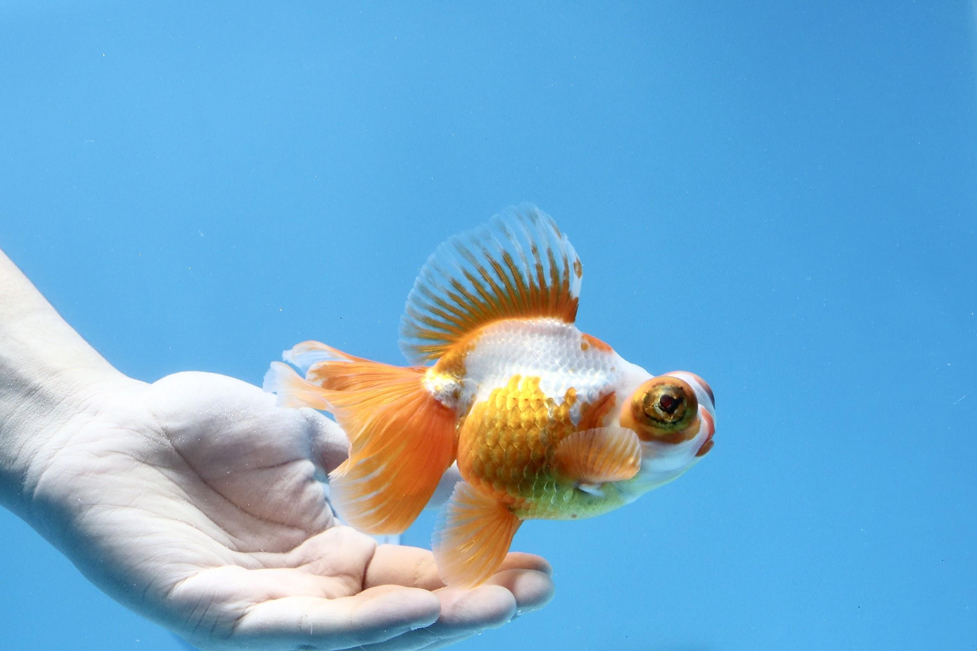
Goldfish Store
Duy Vo
CIT 236
Final Project

Slide 2
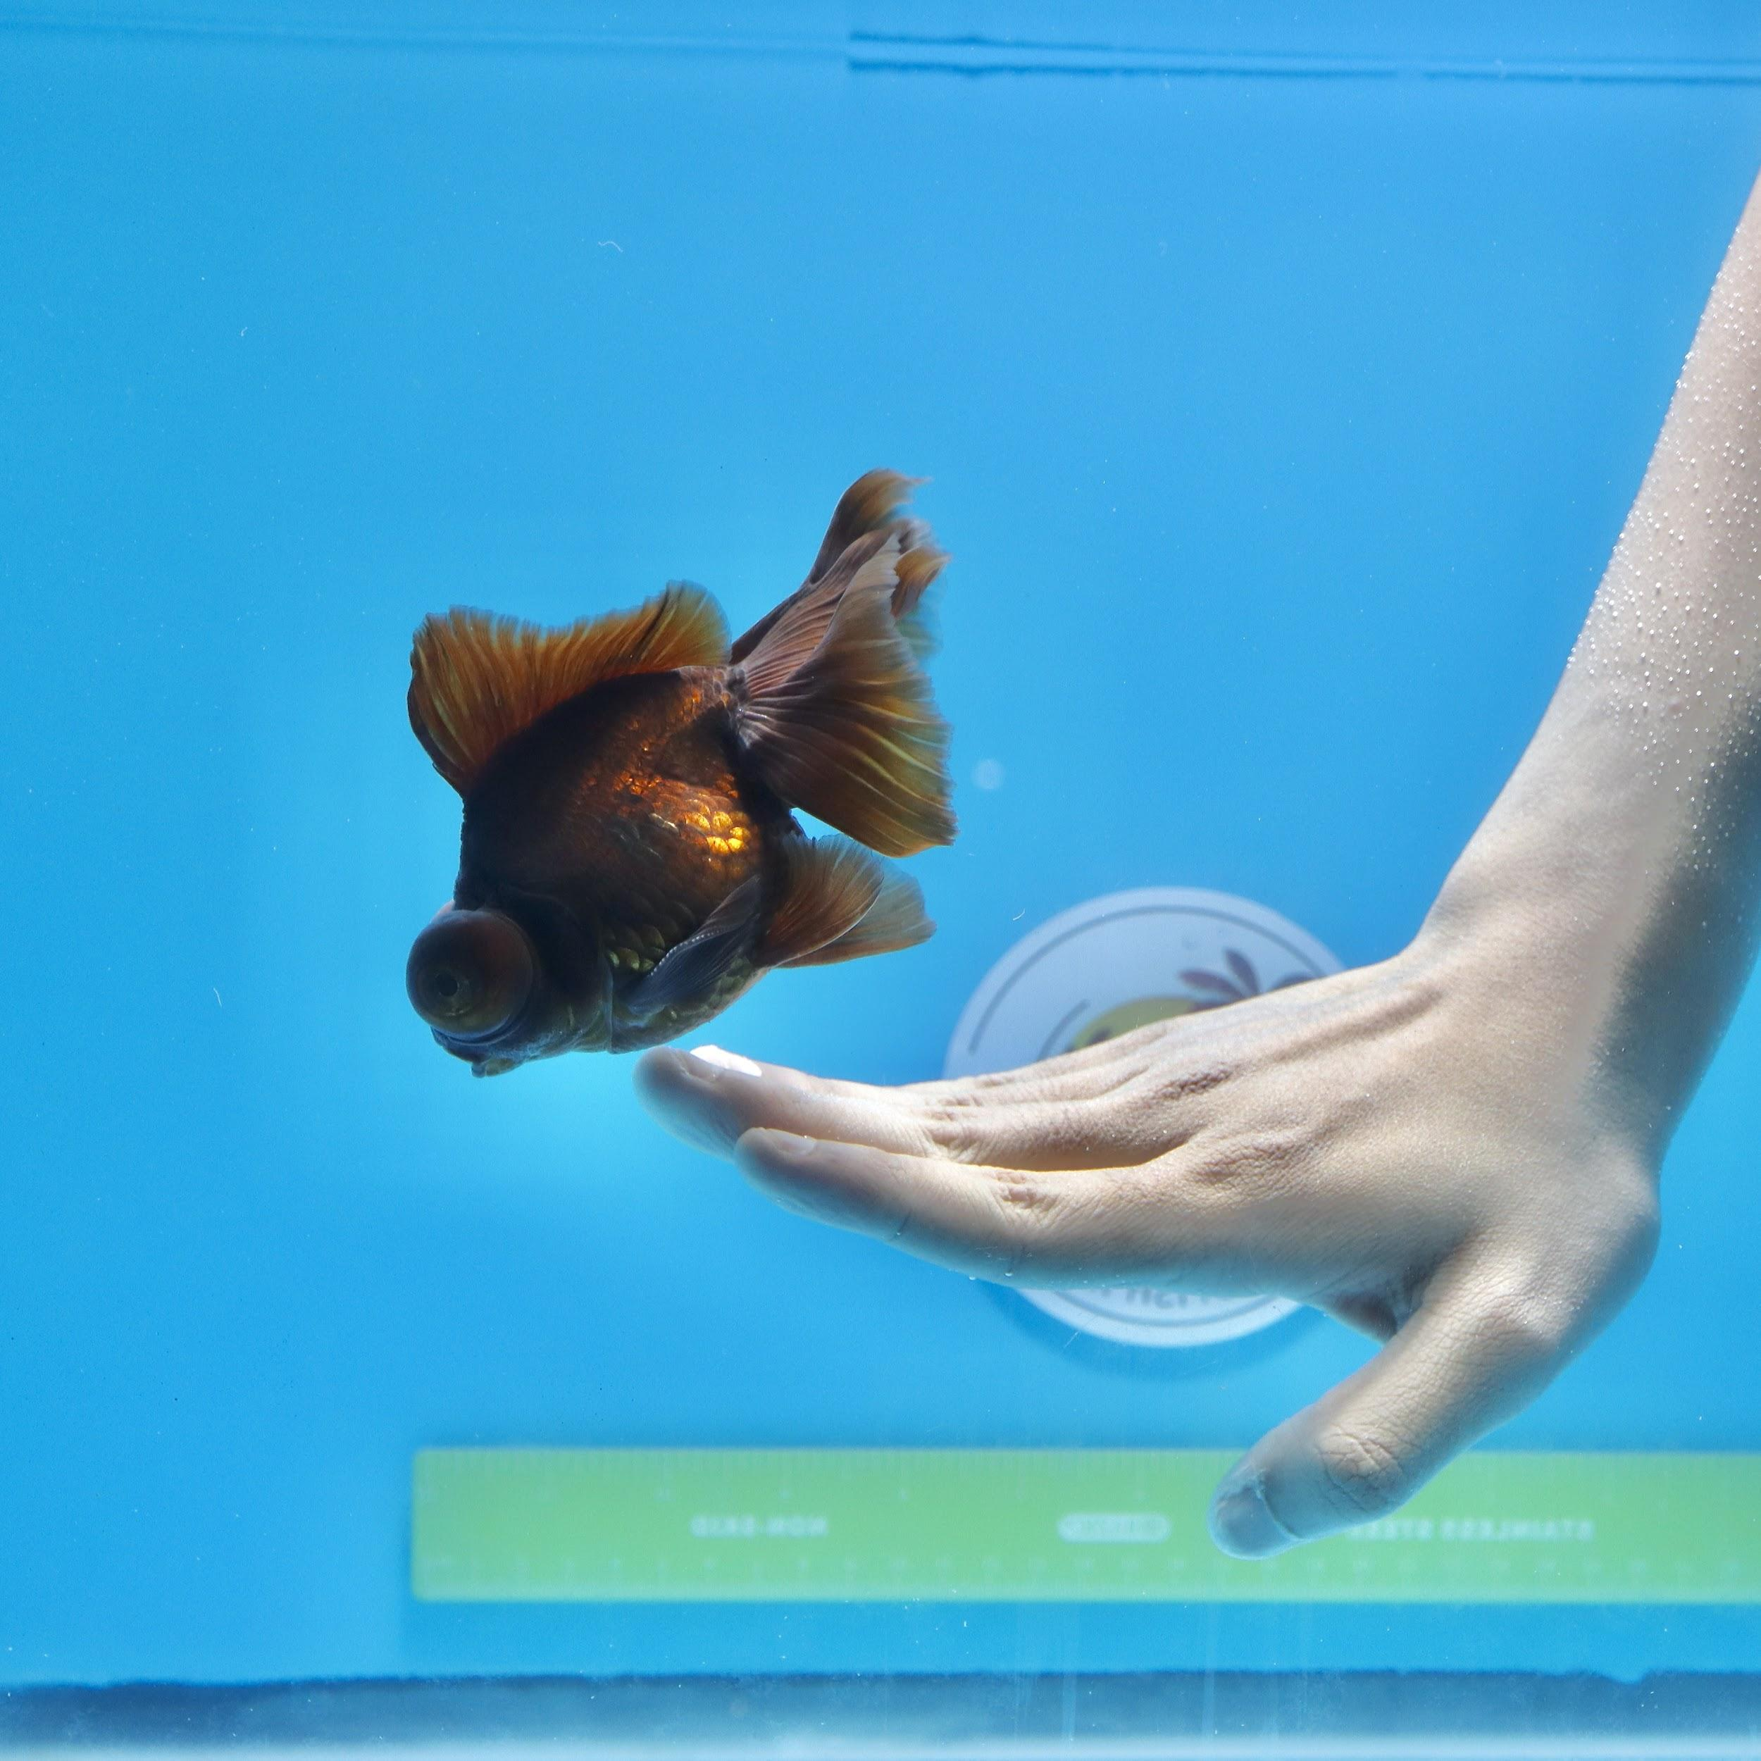
Who We Are?
We are a group of fish lovers, keepers, breeders from Boston, MA. We have been operated locally in the Boston and Greater Boston in the past 30 years since 1989.
Why Us?
We source not only the top quality goldfish but also the quality baby fishes for goldfish lovers to raise them as we all enjoy to see our goldfish growing up.

Slide 3
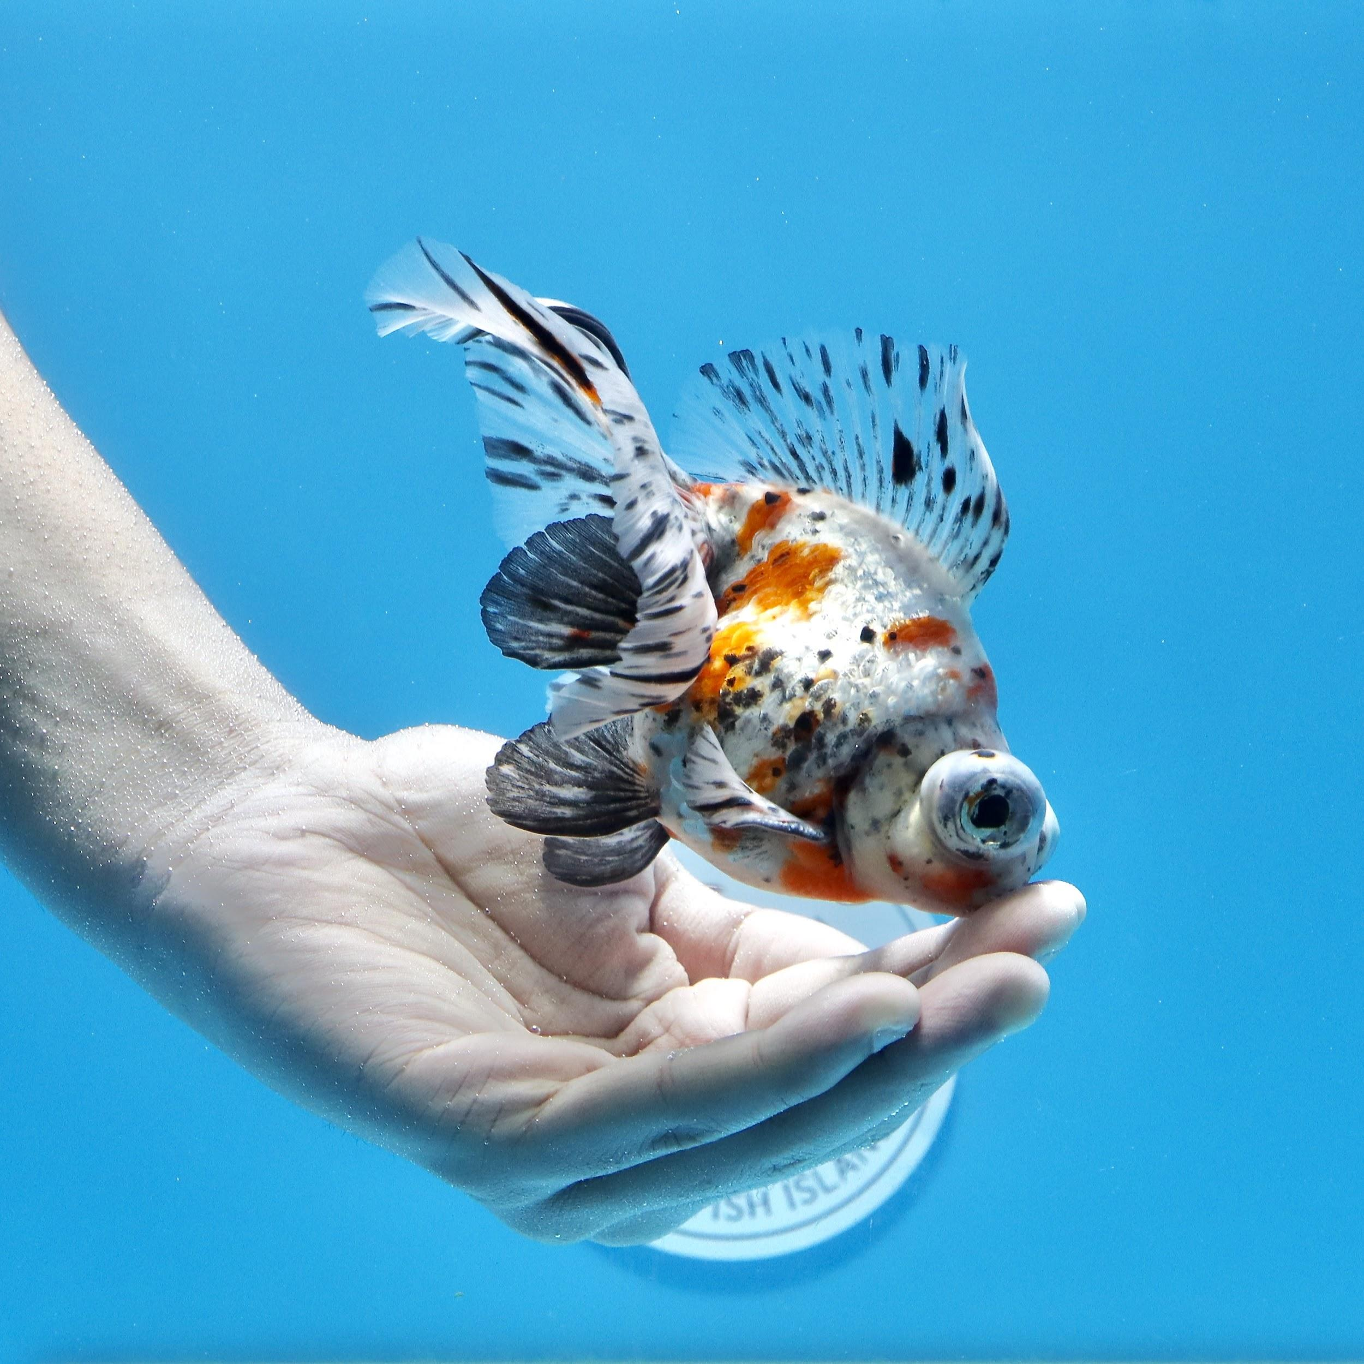
What GoldFish We Offer?
_Butterfly
_Ranchu
_Thai Oranda
_Yuan Bao
_Crown Pearlscale
_Ryukin
_JIKIN

Slide 4
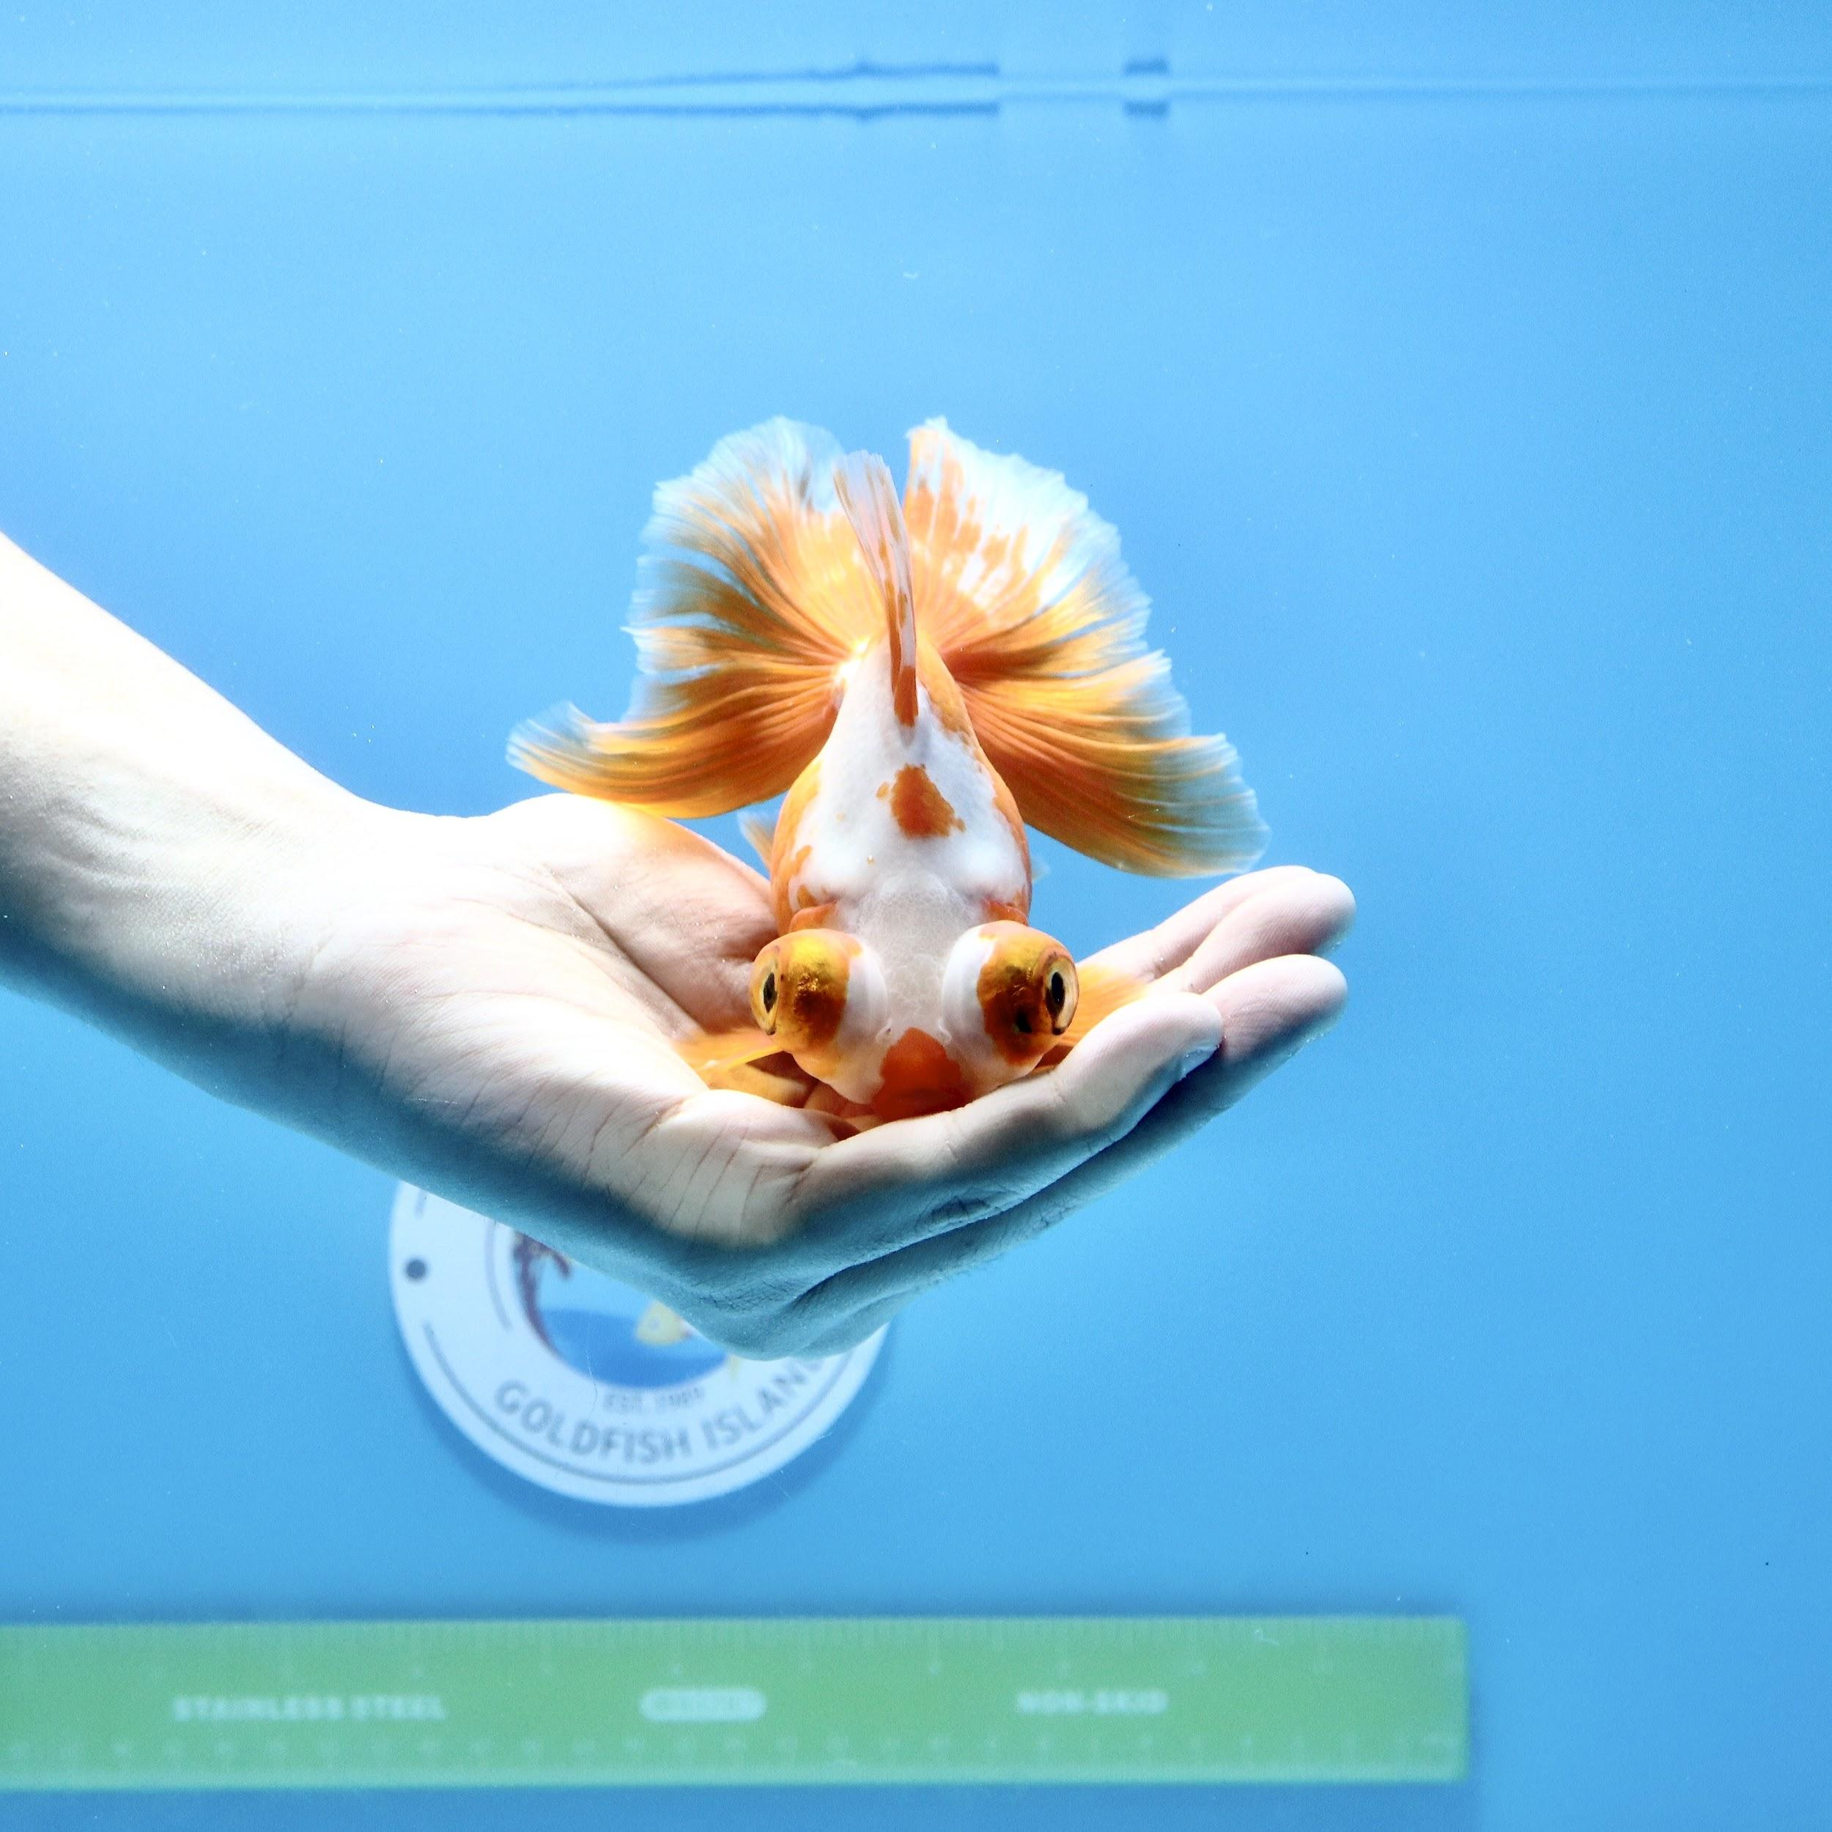
Business Rules:
_ 1 customer can have multiple orders, but 1 specific order purchased by 1 customer.
_ 1 employee can process multiple order, but 1 specific order will be processed by 1 employee.
_ 1 order can have multiple items, but 1 specific item only exist in 1 order
_ 1 orderitem can have multiple sku number, but 1 sku number only appear in 1 orderitem.
_ 1 sku number of fish has only 1 fish name , but 1 fish name can appear in multiple sku number.
_ 1 sku number of fish has only 1 attribute, but 1 attribute can appear in multiple sku number
_ 1 sku number of fish has only 1 color, but 1 color can appear in multiple sku number
_ 1 sku number of fish has only 1 length, but 1 length can appear in multiple sku number
_1 sku number of fish has only 1 gender, but 1 gender can appear in multiple sku number

Slide 5
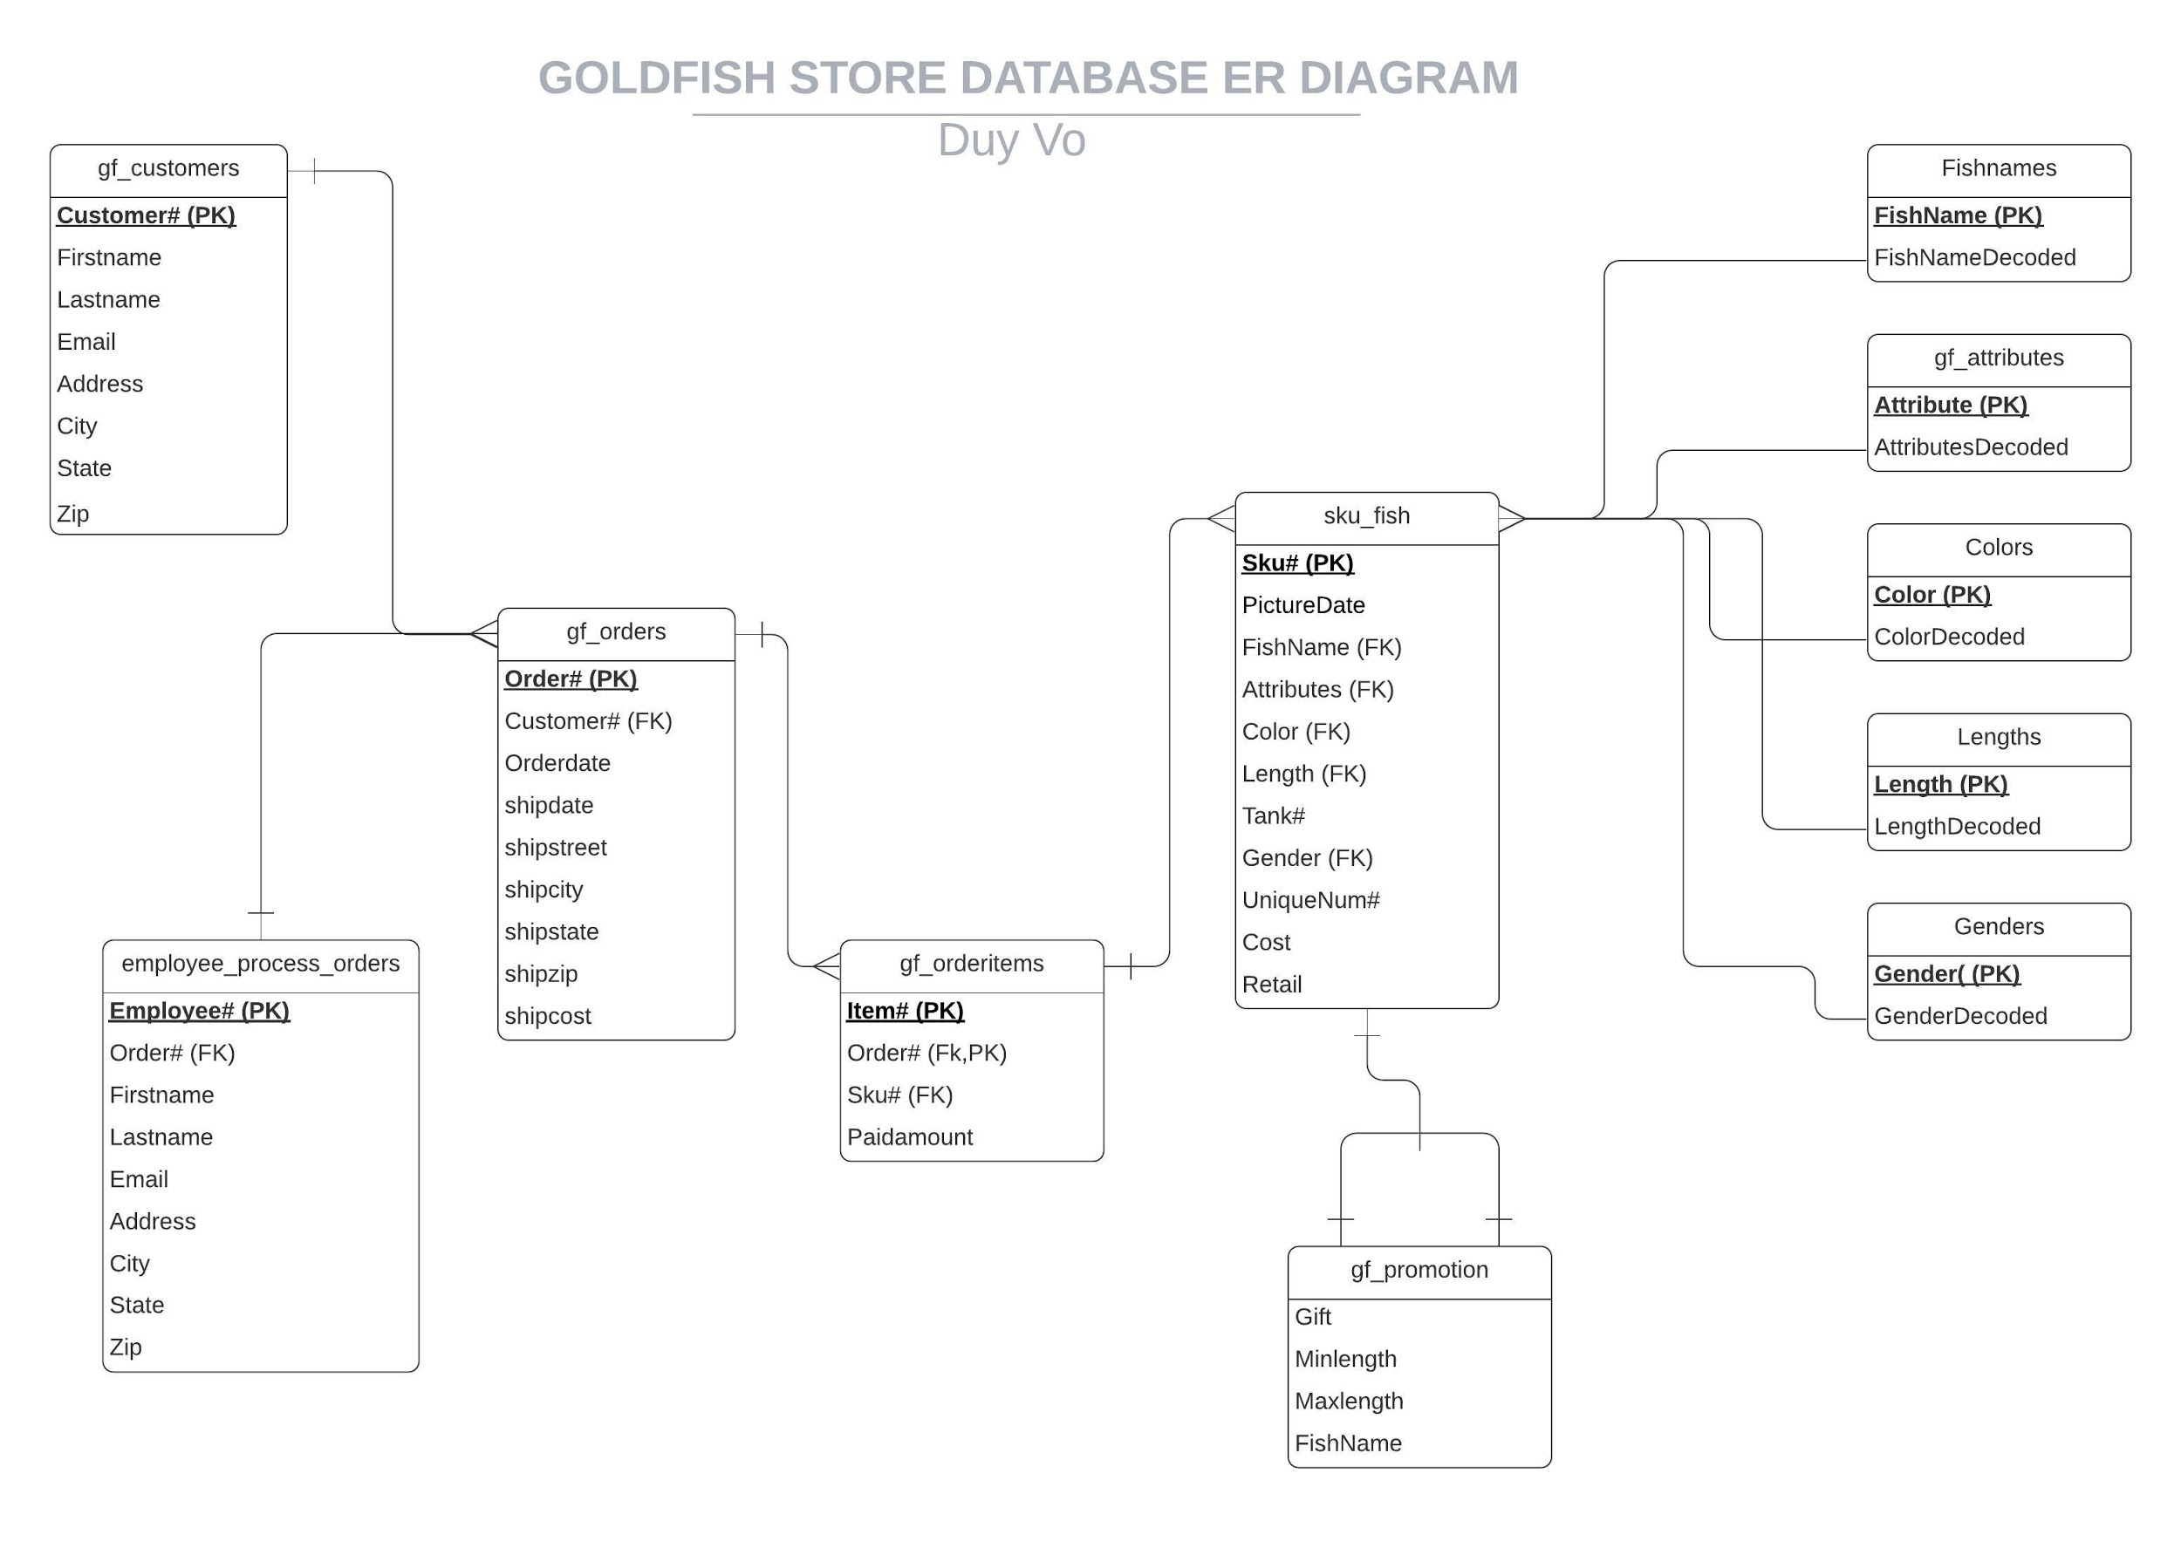

Slide 6
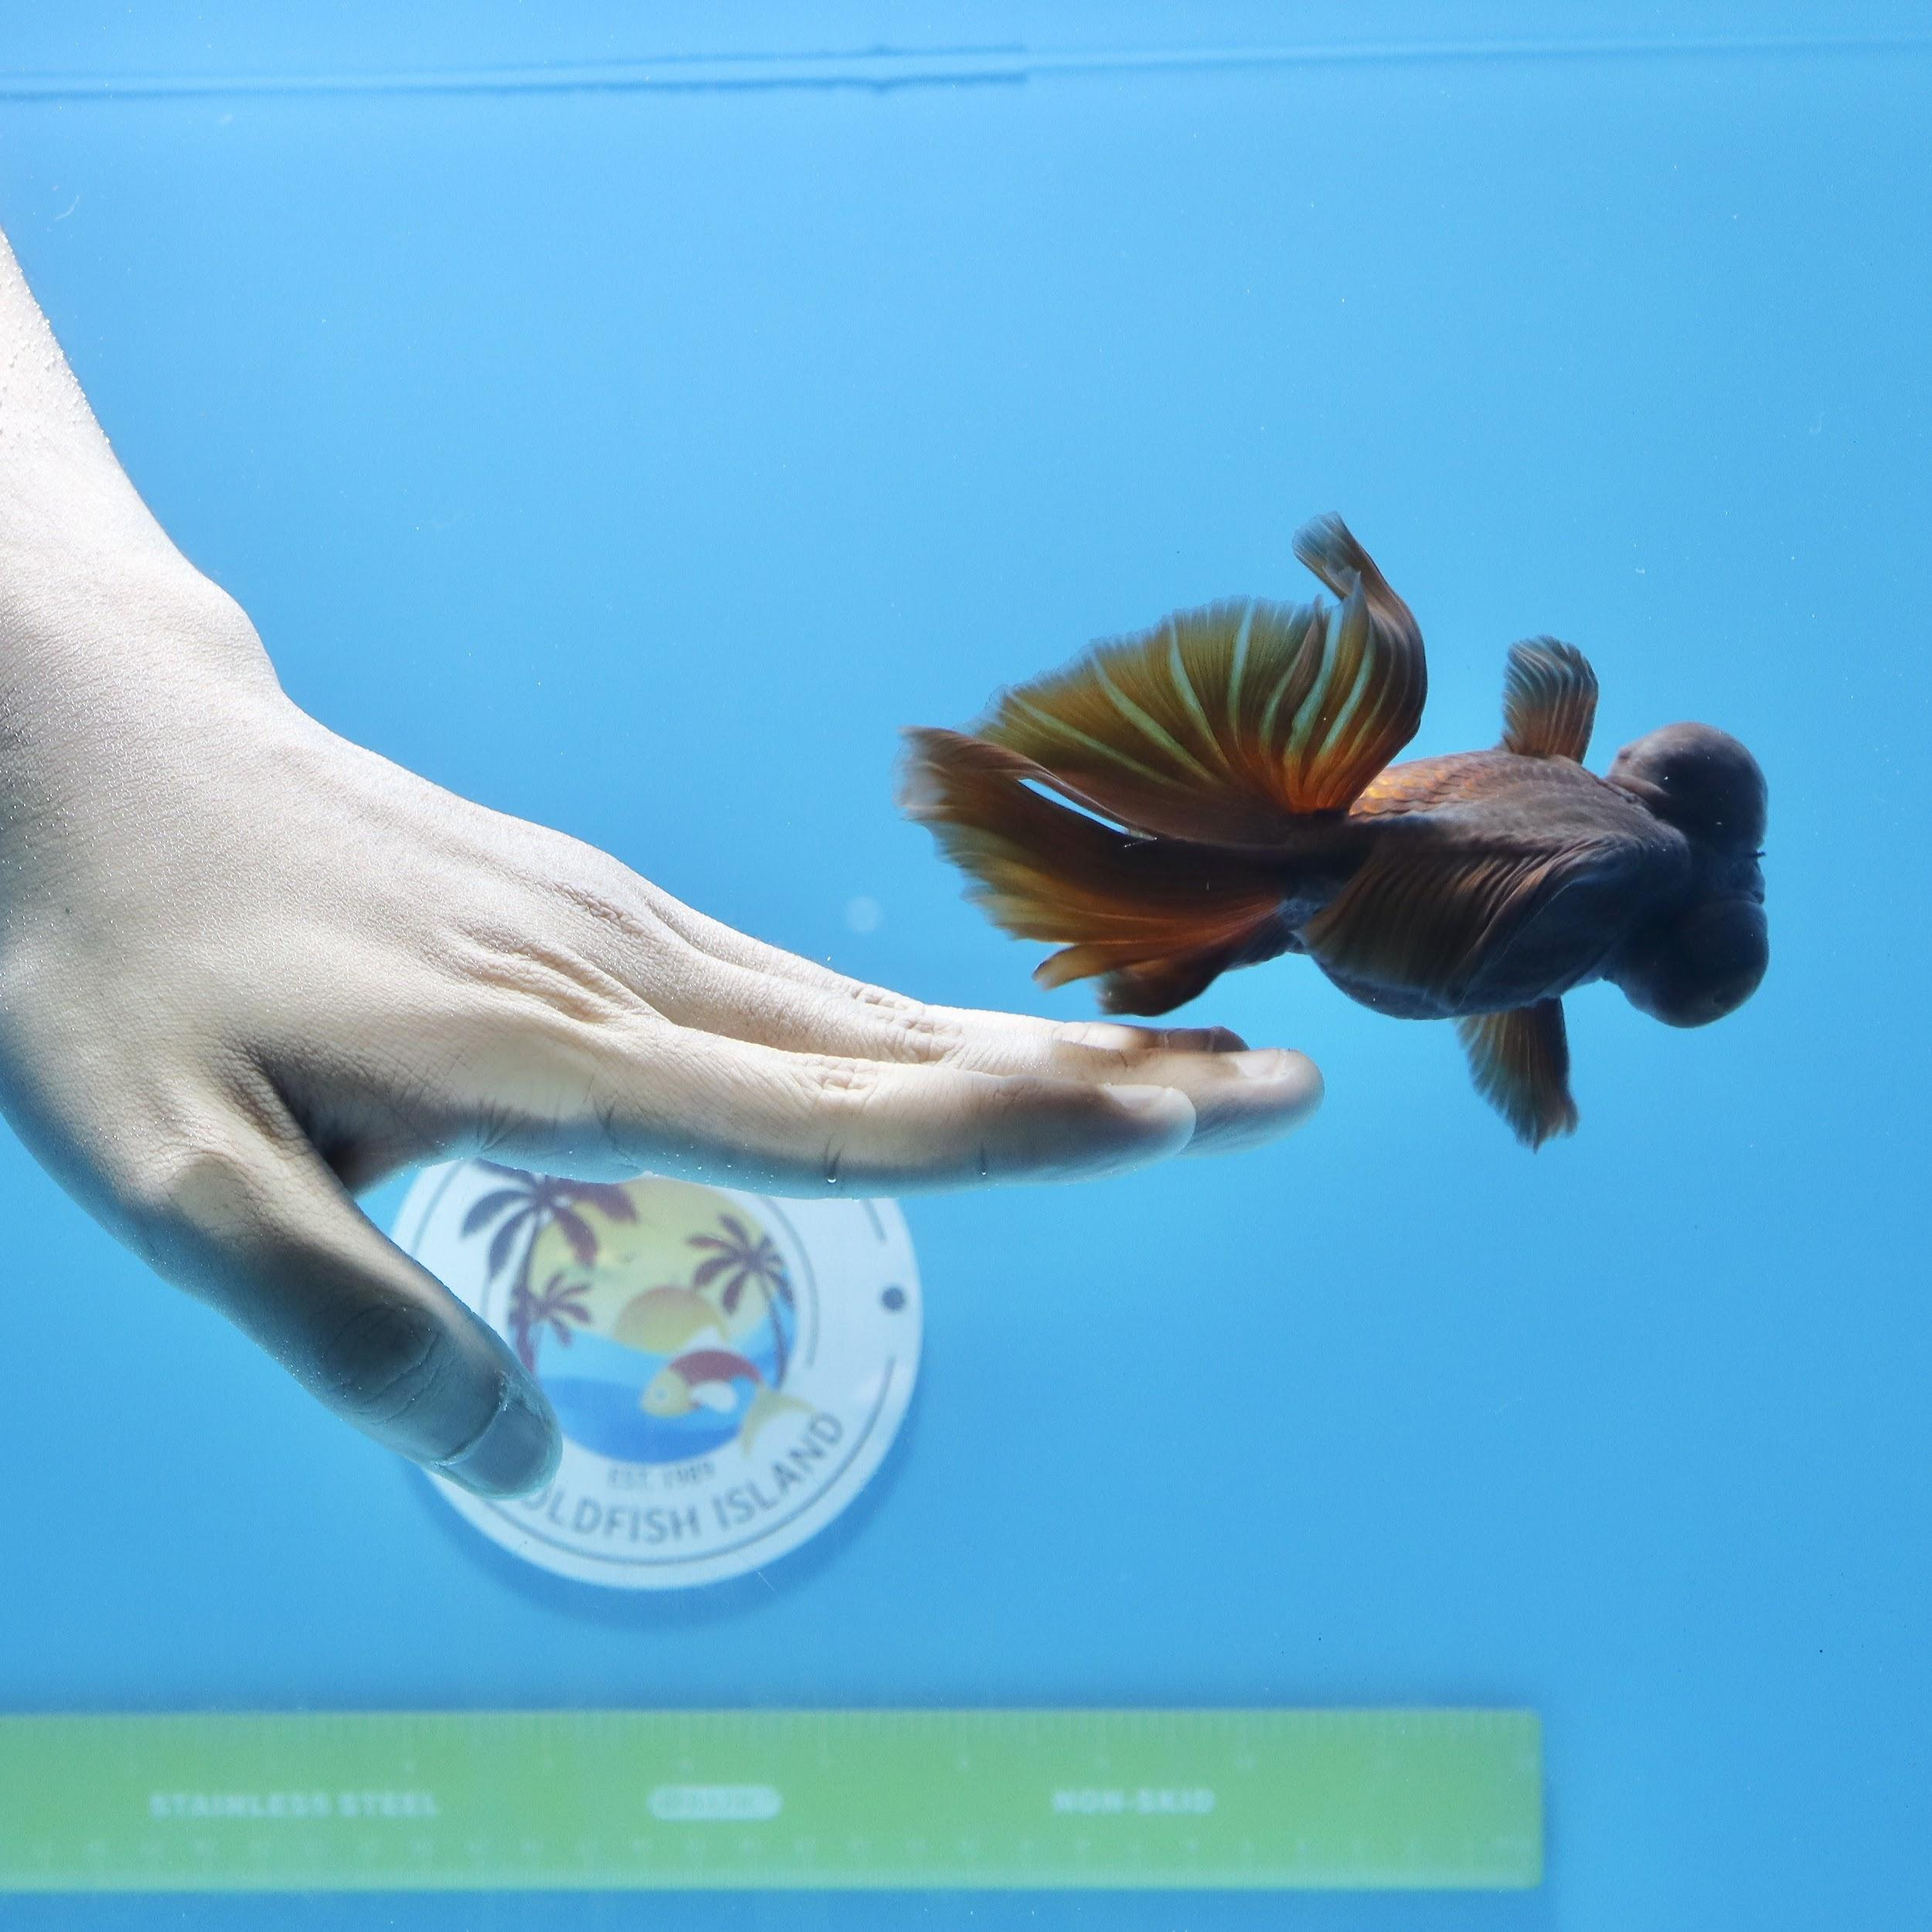
Question and answer queries.
Chapter 8
Q1.Which customer live in Massachusetts? list each customer's last name , first name, and state?
SELECT lastname, firstname, state
FROM gf_customers
WHERE state IN ('MA');
Q2. List all sku# with a cost price greater than $40.00. Sort the list by cost in descending order.
SELECT sku#, cost
FROM sku_fish
WHERE cost > 40.00
ORDER BY cost DESC;

Slide 7
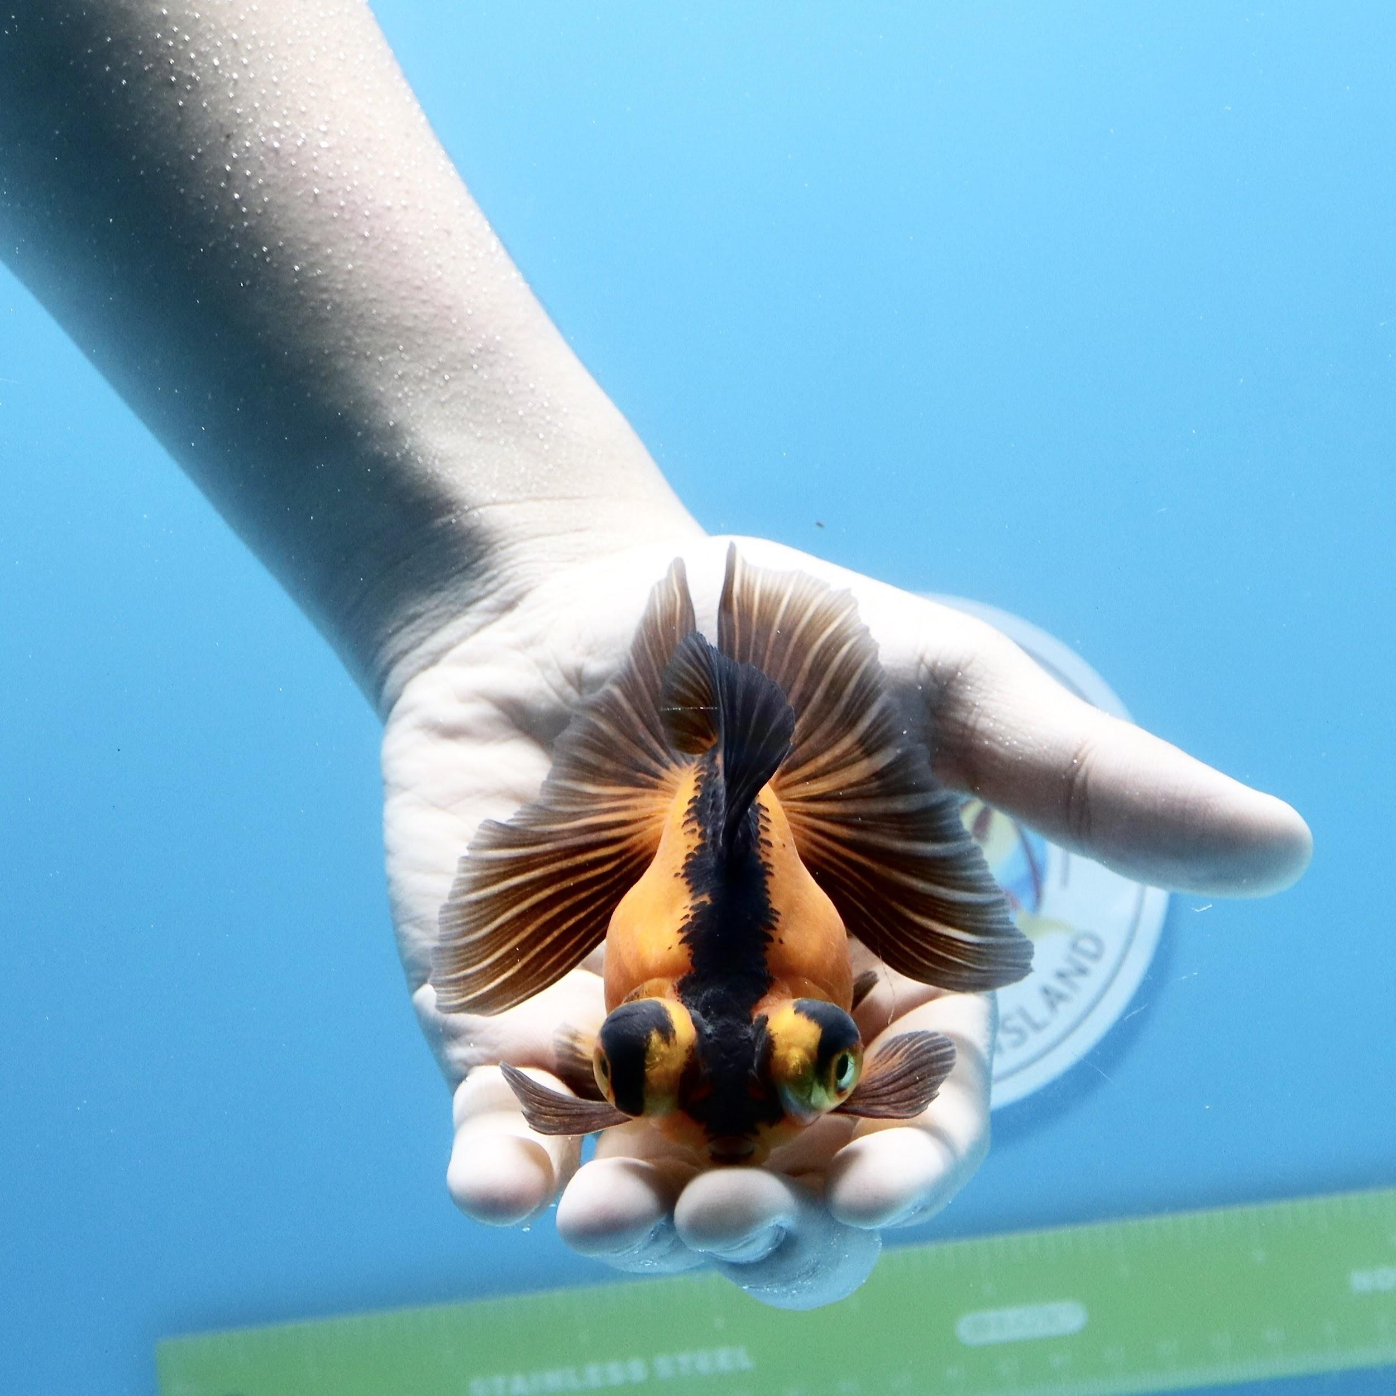
Chapter 9
Q1. Determine which orders haven't yet shipped and the name of the customer who placed the order. Sort the results by first name.
SELECT order#, firstname ||' '|| lastname AS "customer's name", orderdate, shipdate
FROM gf_customers JOIN gf_orders USING (customer#)
WHERE shipdate IS NULL
ORDER BY firstname;
Q2. List all customers who ordered butterfly fish.
SELECT firstname ||' '|| lastname AS "customer's name", fishname
FROM gf_customers JOIN gf_orders USING (customer#)
JOIN gf_orderitems USING (order#)
JOIN sku_fish USING (sku#)
JOIN fishnames USING (fishname)
WHERE fishnamedecoded = 'Butterfly';

Slide 8
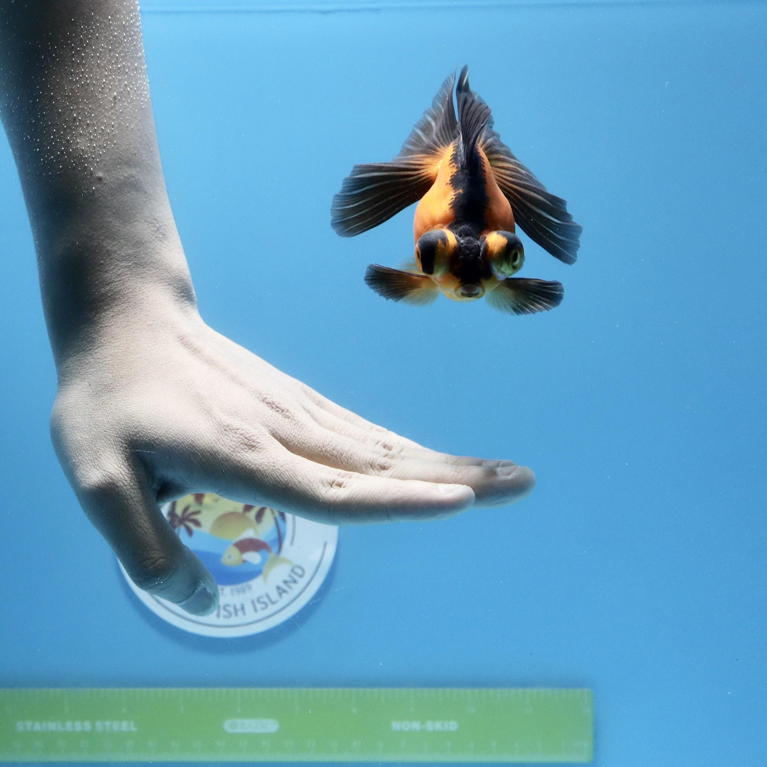
Chapter 10
Q1. Using today's date, determine the age (in months) of each fish that store sells. Make sure only whole months are displayed, ignore any portion of months. Display the order#, sku#, fishnamedecoded, picture date, and age. Sort the list by order.
SELECT order#, sku#, fishnamedecoded AS "name of fish", picturedate, TRUNC(MONTHS_BETWEEN(sysdate,picturedate),0) AS "age of fish was sold in months"
FROM gf_customers JOIN gf_orders USING (customer#)
JOIN gf_orderitems USING (order#)
JOIN sku_fish USING (sku#)
JOIN fishnames USING (fishname)
ORDER BY order#;
Q2. Determine employee processed orders with sku# = 0817YUHQKI758TY7F1. list order#, employee name and his/her street address, precede each street address with plus sign so the width of the displayed address field is 25.
SELECT order#, firstname ||' '|| lastname AS "employee's name", LPAD(address, 25, '+') AS "street address", sku#
FROM employee_process_orders JOIN gf_orders USING (order#)
JOIN gf_orderitems USING (order#)
WHERE sku# = '0817YUHQKI758TY7F1';

Slide 9
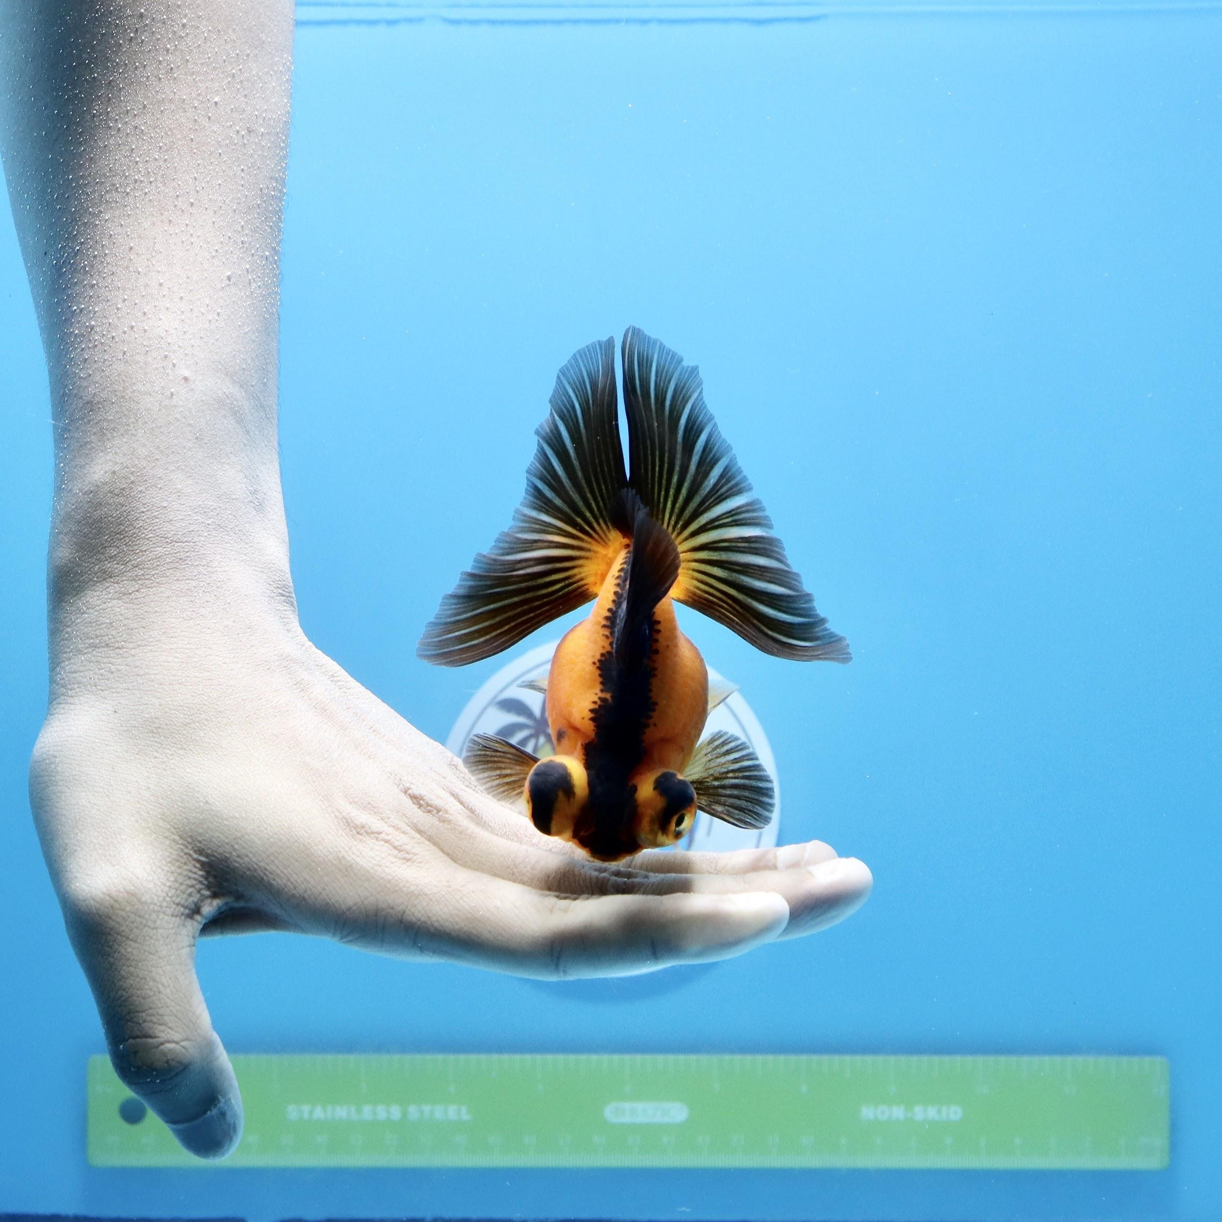
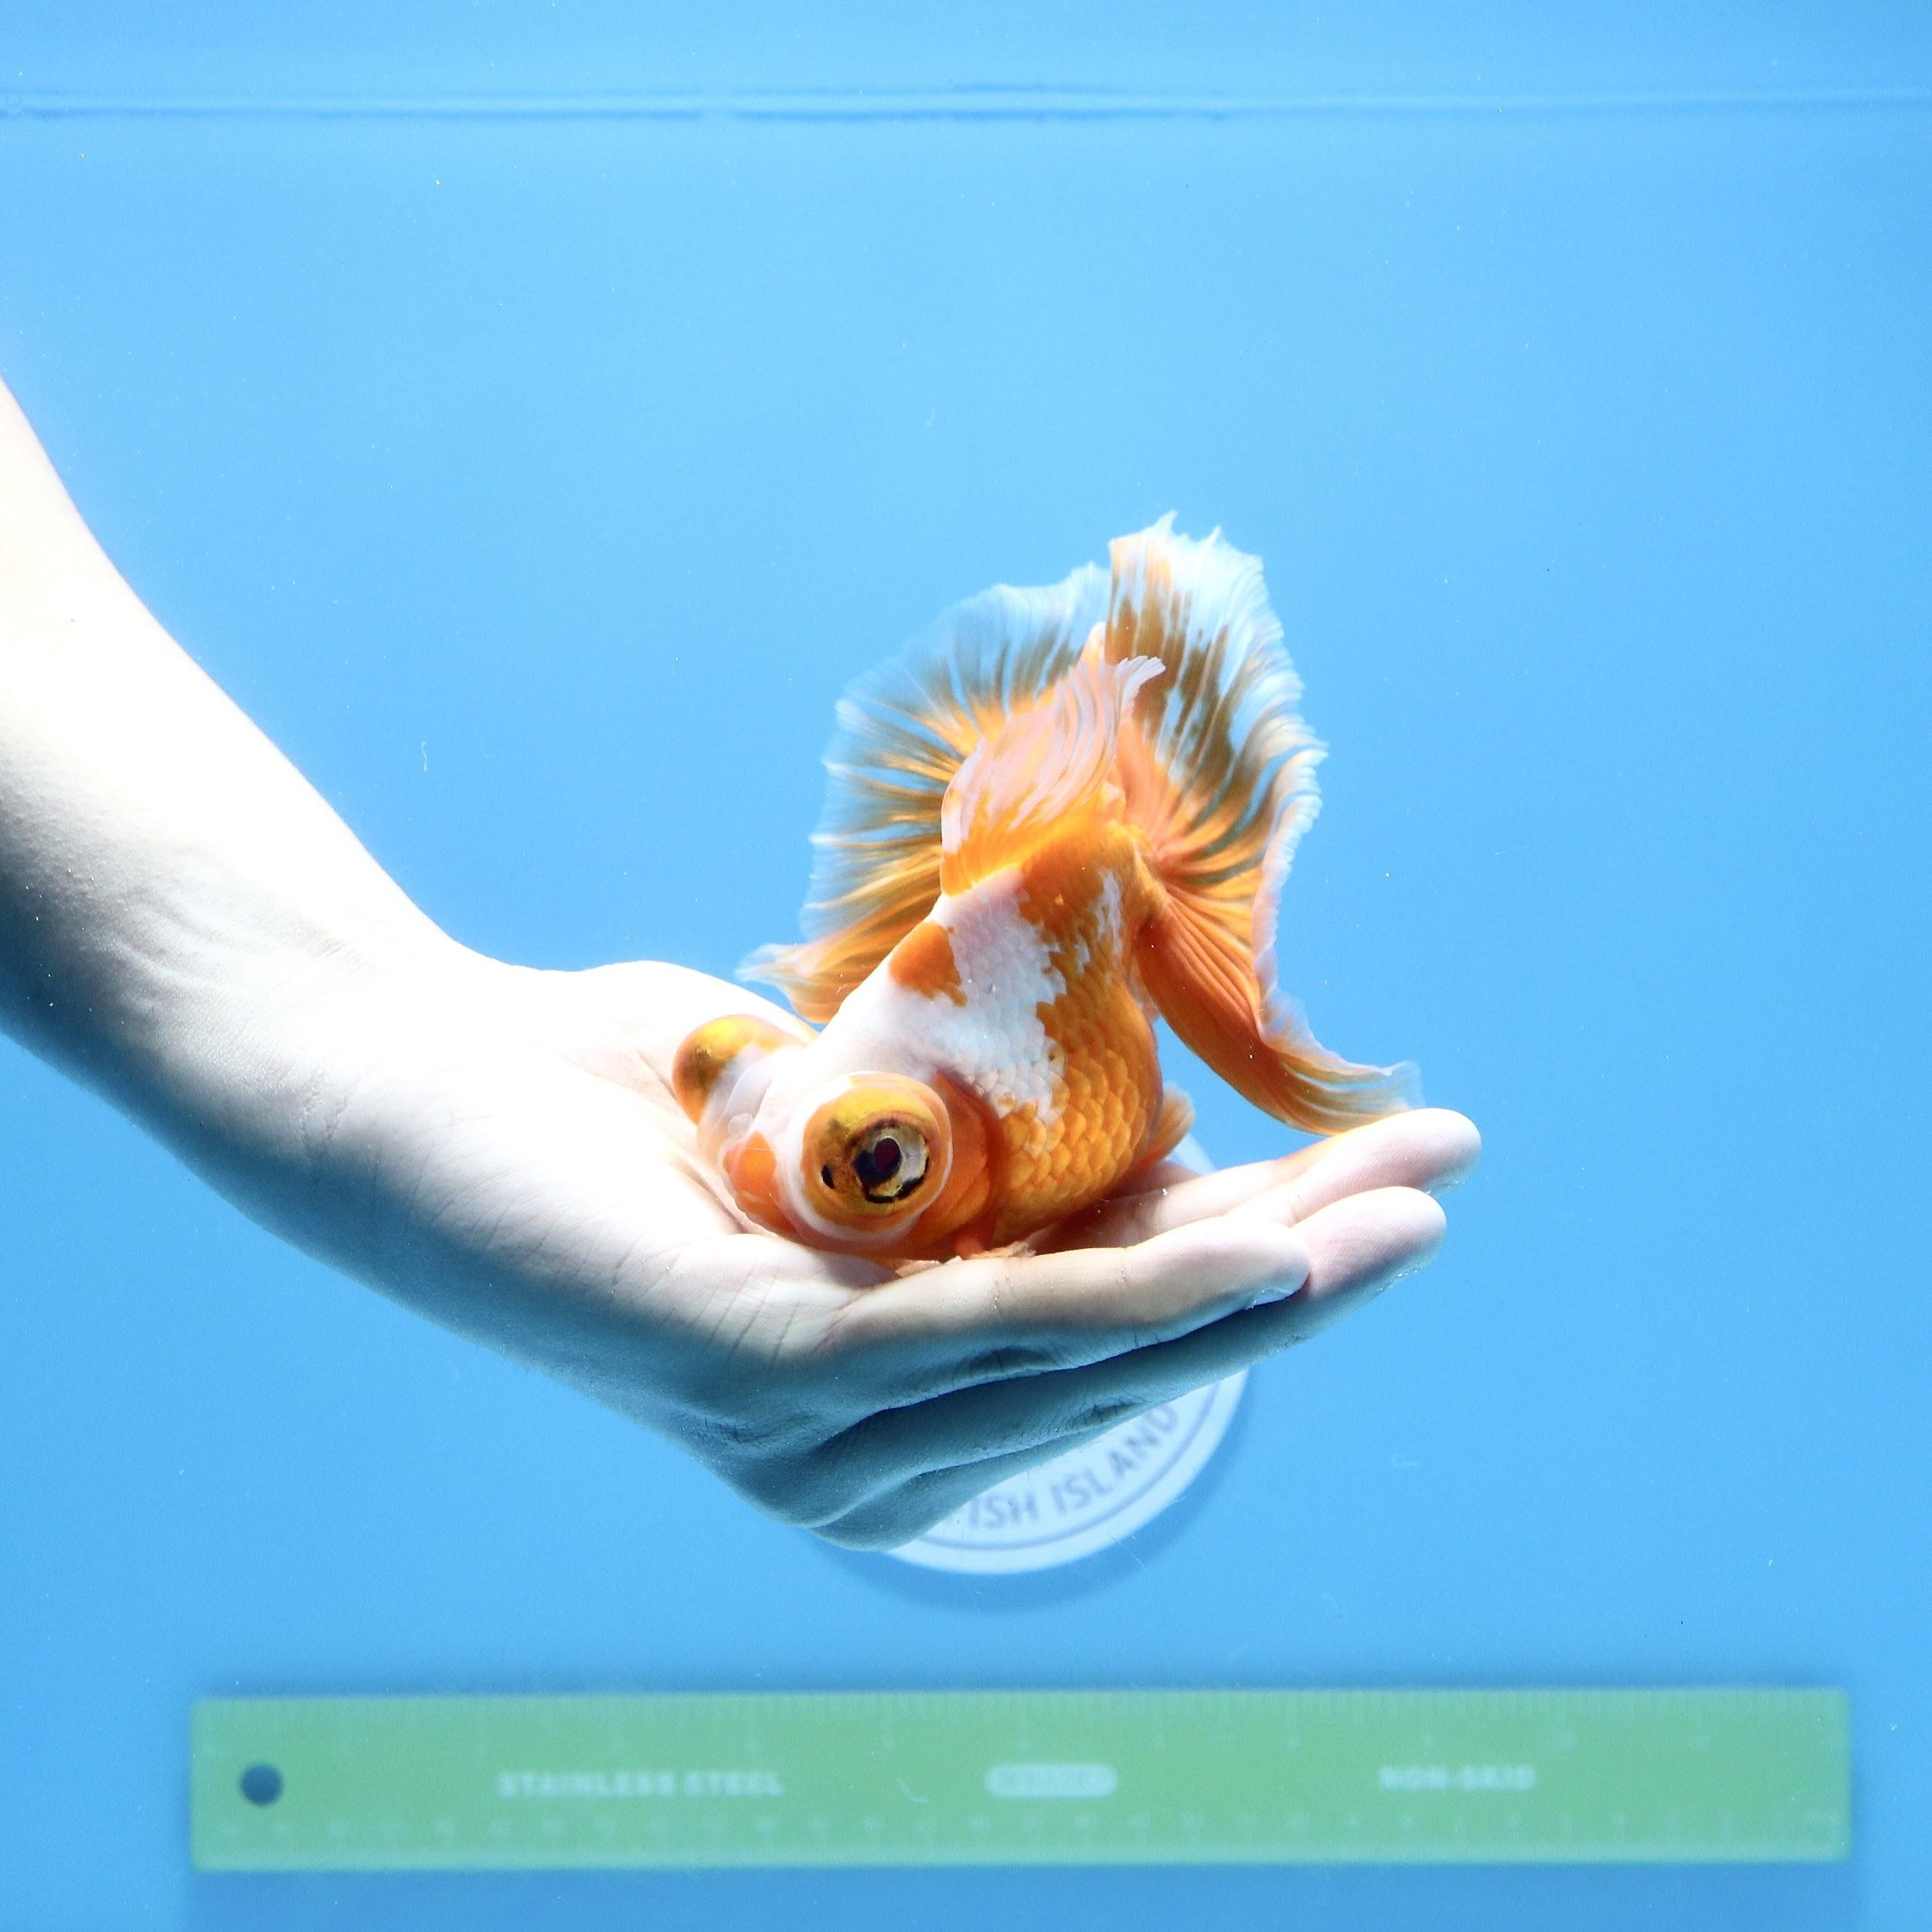
Chapter 11
Q1. Find the average retail price of 6.7 to 7 inch and 7.5 to 8 inch fish, use a single query to show the average for those lengths fish.
SELECT lengthdecoded AS "length of fish", TO_CHAR(AVG(retail),'$999.99') AS "average retail price"
FROM sku_fish JOIN lengths USING (length)
WHERE UPPER(lengthdecoded) = '6.5 TO 7 INCH' OR UPPER(lengthdecoded) = '7.5 TO 8 INCH'
GROUP BY lengthdecoded;
Q2. List customers from New Jersey and Massachusetts Who placed orders totaling over $70. Aggregate per order, per customer. Sort the list by total.
SELECT Order#, firstname ||' '||lastname AS "customer's name", TO_CHAR(SUM(paidamount),'$999.99') AS "total"
FROM gf_customers JOIN gf_orders USING (Customer#)
JOIN gf_orderitems USING (order#)
WHERE UPPER(Shipstate) IN ('NJ','MA')
GROUP BY Order#, Customer#, Firstname, Lastname
HAVING SUM(paidamount) > 70
ORDER BY SUM(paidamount);

Slide 10
Chapter 12
Q1. List the customers who placed an order for the least expensive fish, include the fish name decoded, price of the fish in your output.
SELECT firstname ||' '|| lastname AS "customer's name", fishnamedecoded AS "fish name", retail AS "price"
FROM gf_customers JOIN gf_orders USING (customer#)
JOIN gf_orderitems USING (order#)
JOIN sku_fish USING (sku#)
JOIN fishnames USING (fishname)
WHERE retail = (SELECT MIN(retail) FROM sku_fish);
Q2. List the gift for all orders with butterfly fish. Sort by order#, include the sku#, retail price, fish name and length of the fish.
SELECT DISTINCT oi.order#, sk.sku#, p.gift, sk.retail, fi.fishnamedecoded AS "fish name", l.lengthdecoded AS "length"
FROM gf_customers c, gf_orders o, gf_orderitems oi, sku_fish sk, gf_promotion p, fishnames fi, lengths l
WHERE c.customer# = o.customer#
AND o.order# = oi.order#
AND oi.sku# = sk.sku#
AND sk.fishname = fi.fishname
AND sk.length = l.length
AND sk.length BETWEEN p.minlength AND p.maxlength
AND sk.fishname IN (SELECT fishname FROM gf_promotion WHERE UPPER(fishname) = 'BU')
ORDER BY order#;

Slide 11
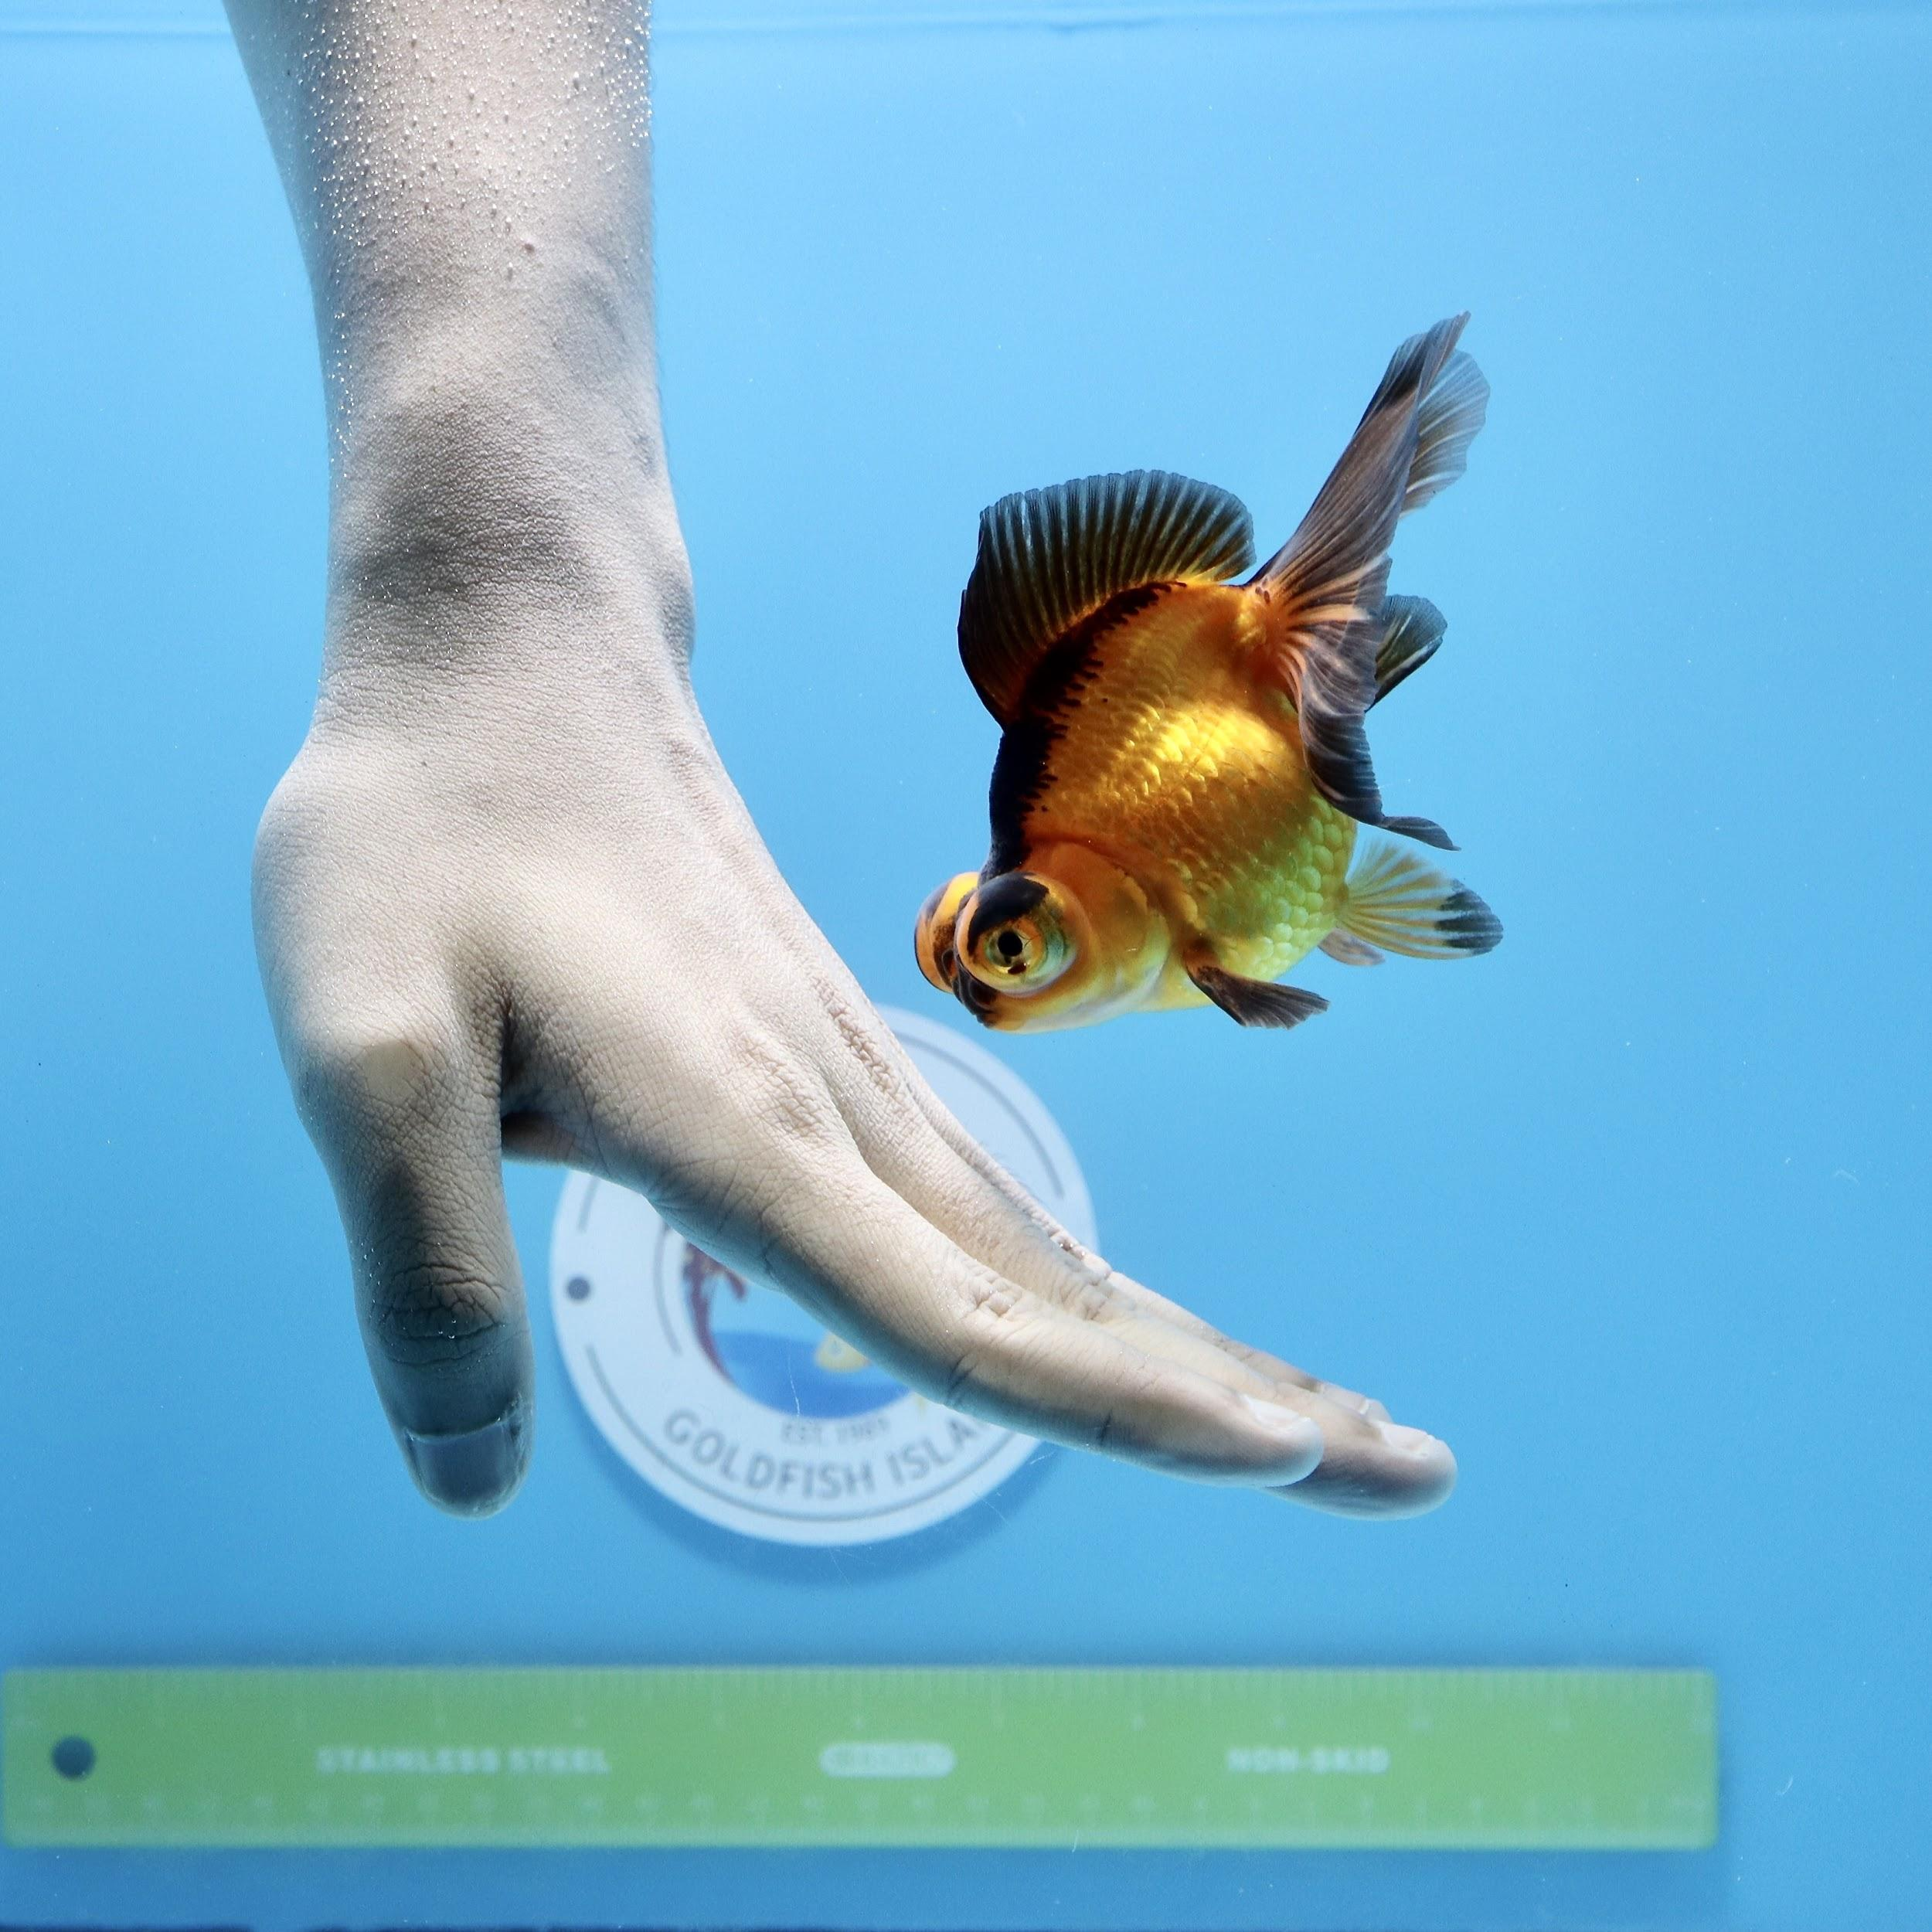
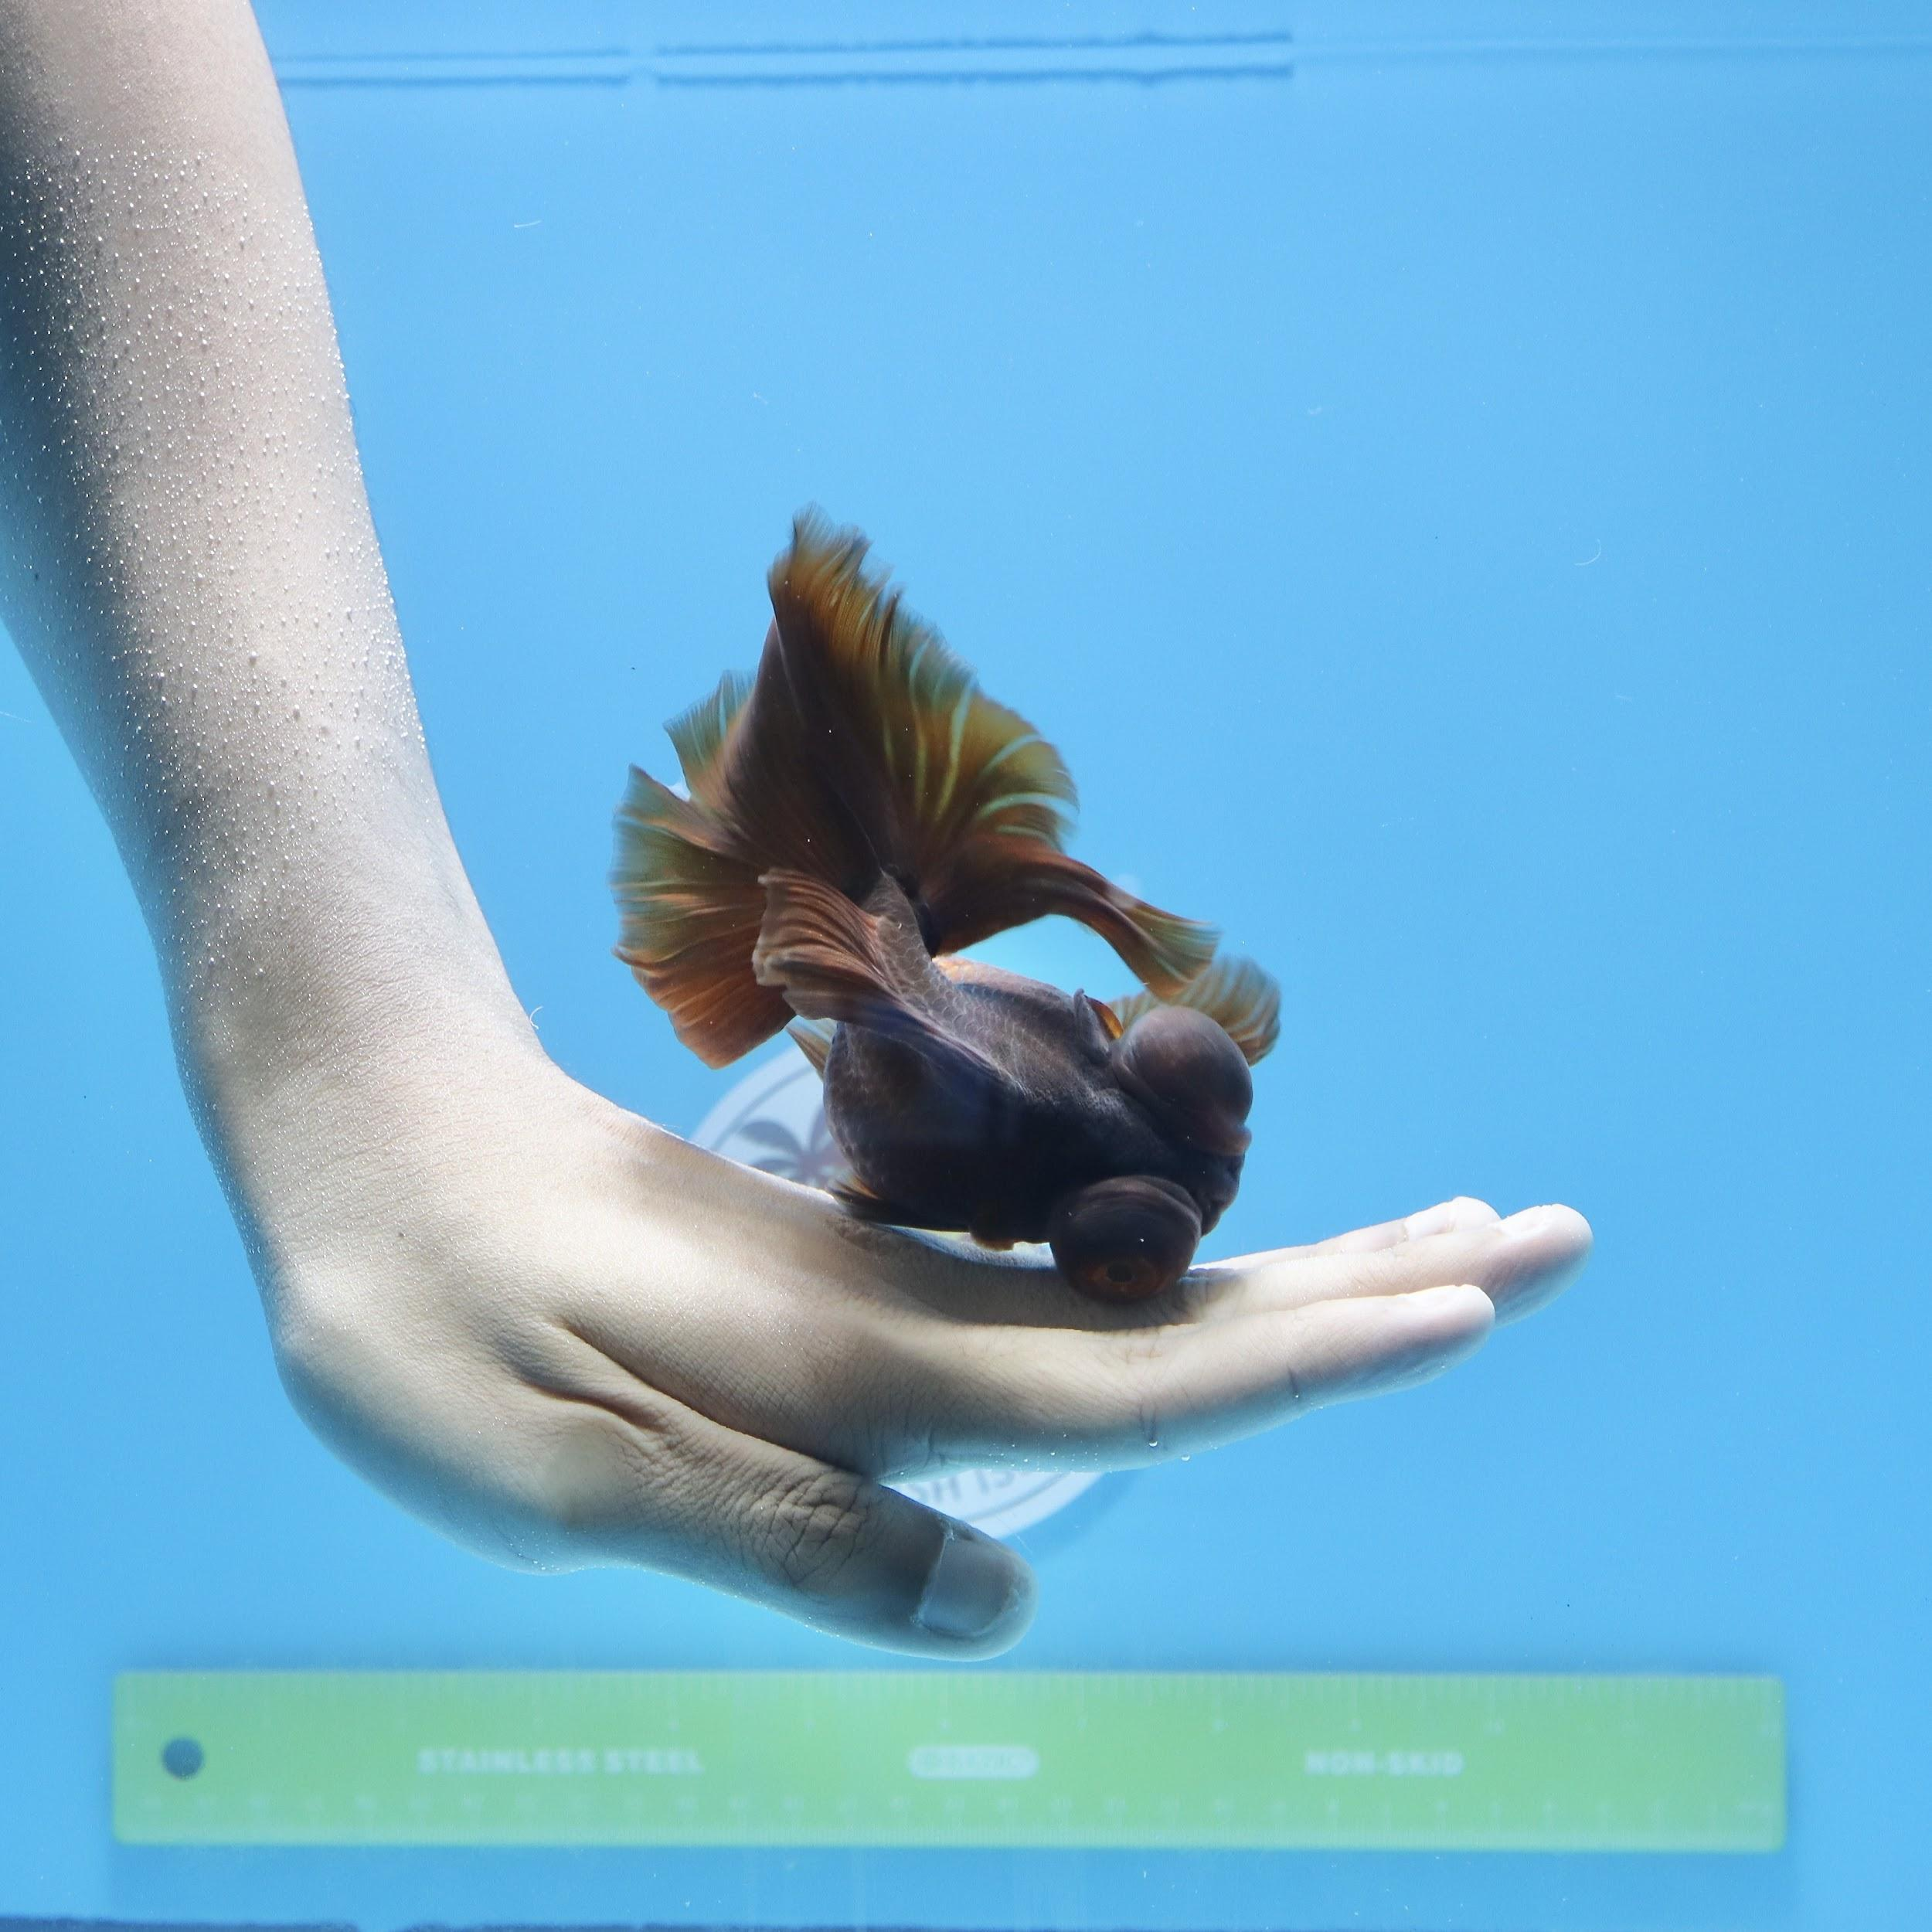
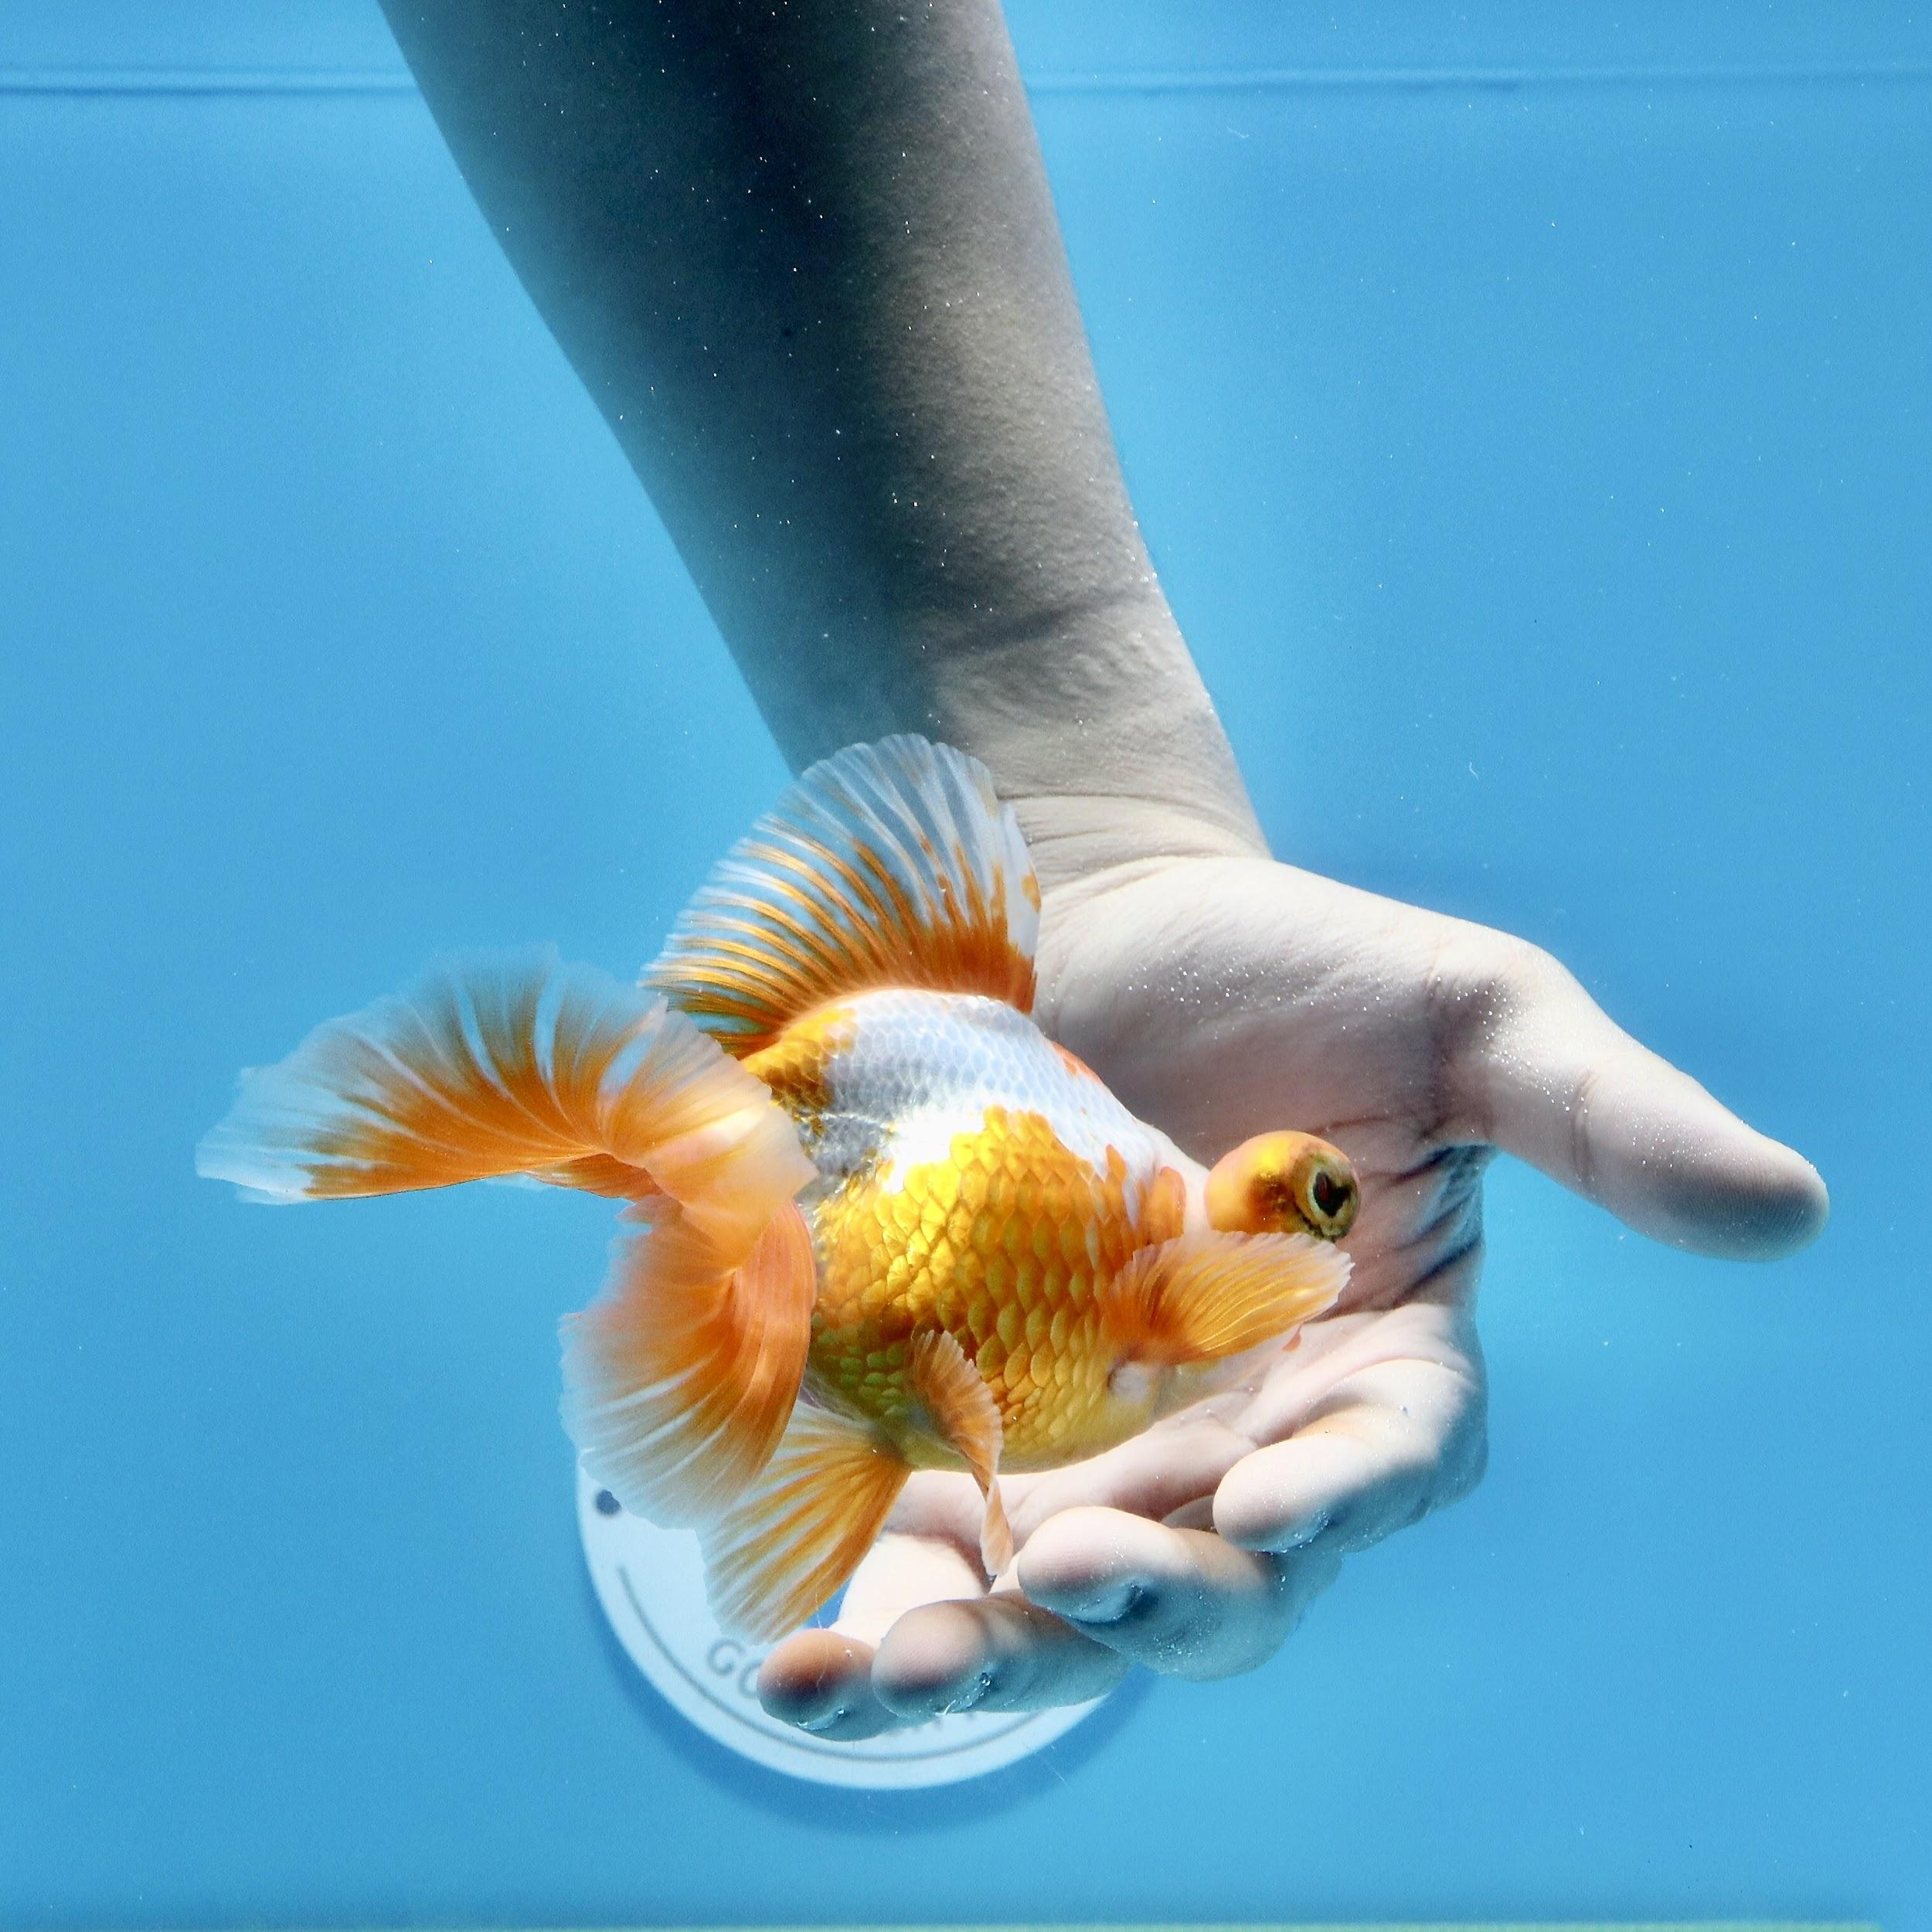
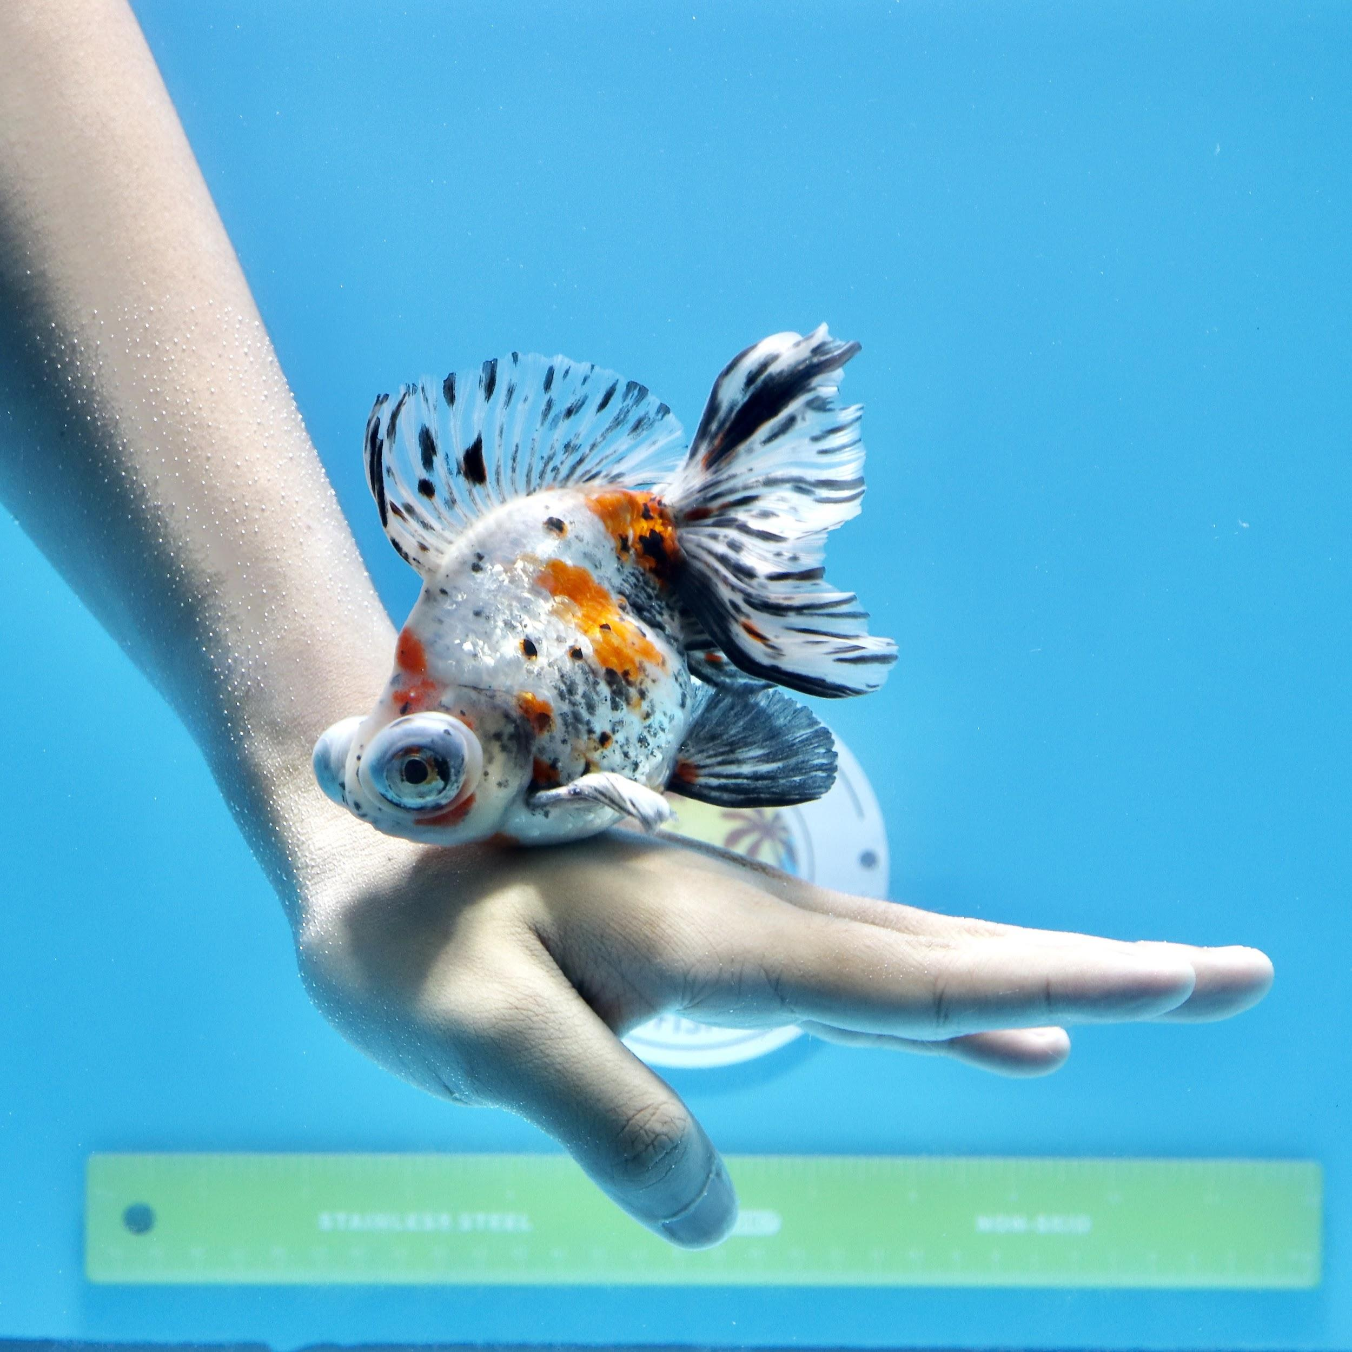
THANK YOU

